Slide 1




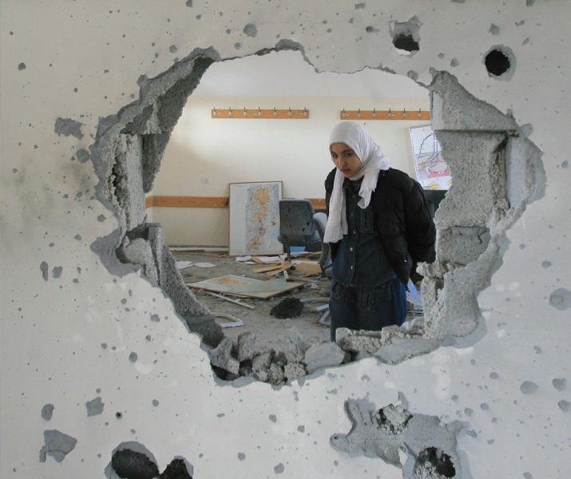
INEE Conflict Sensitive
Education Training
Washington, DC
November 6-7, 2017
Notes:
Nina

Slide 2
Conflict Sensitive Strategies for Domain 3:
Teaching and Learning
Julia Finder, Creative Associates International
Module 5

Slide 3
At the end of this module participants will:
Understand the interactions between conflict and teaching and learning.
Be able to apply conflict sensitive strategies for Domain 3: Teaching and Learning based on conflict analysis findings.

Slide 4
Notes:
Direct people to Pg. 29, ask for volunteers to read this section.

Slide 5
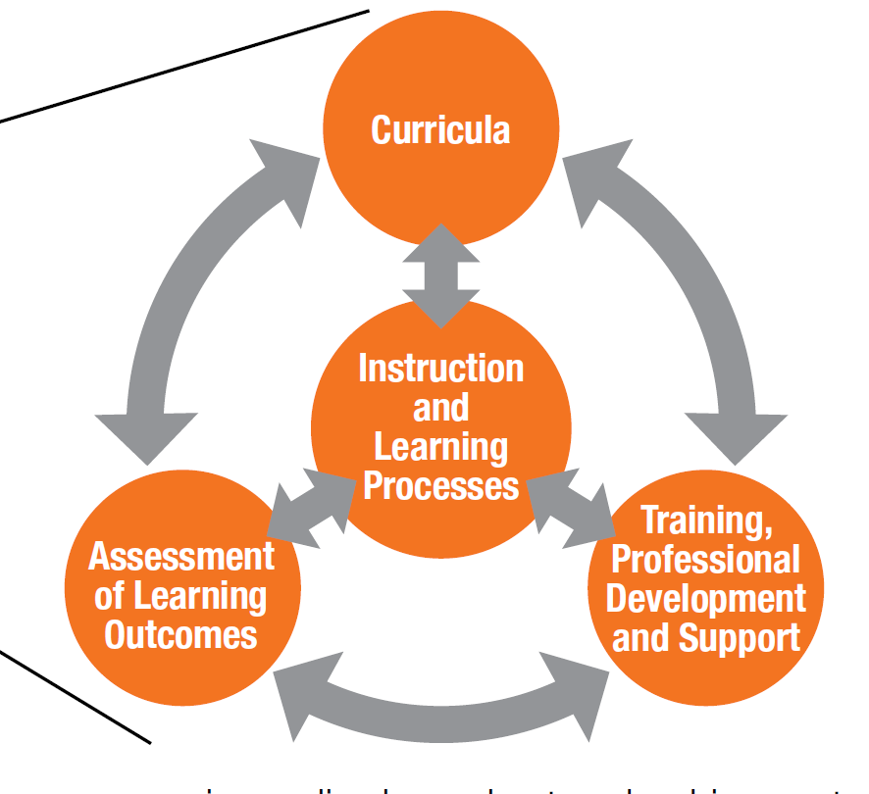
Teaching and Learning Domains
Notes:
As illustrated in the diagram, above, the teaching and learning process is cyclical; each standard impacts and
enables the success of the others. One standard cannot be considered without taking into account the strengths,
weaknesses, opportunities and threats of the others.

Slide 6
Think, Pair, Share: How does conflict interact with teaching and learning?
Teaching and Learning
Conflict
Notes:
Ask: How can activities related to teaching and learning—such as curricula, assessments, and instruction— contribute to conflict?
Curricula: learning materials are in only the dominant groups language, discriminatory representation of one ethnic group, history lessons that do not portray important historical events objectively.
Facilitator’s Note: If participants are not familiar with these terms explain that curricula refers to the course of study, or subjects in a learning program. Bias refers to an attitude, belief or feeling that results in unfair treatment of a person because of his or her identity.
Training professional development and support: teachers without training in positive discipline, peaceful conflict resolution, and human rights. Teachers who do not adhere to a professional code of conduct of behavior. Teachers who are un- or under-paid.
Instruction and learning processes: teacher modeling stereotypes and prejudice, barriers due to language of instruction, exclusion of specific groups due to lack of relevant content (child-soldiers, over-age students, returnees, victims of GBV), humiliating and violent forms of student discipline.
Assessment (tests or exams) of learning outcomes: lack of exam reciprocity (two bordering countries agree to acknowledge the exams of the other for the displaced populations) leading to youth grievances.
Ask: How does conflict impact teaching and learning?
Training professional development and support: conflict disrupting in-service training for teachers, conflict causing quick hiring processes of untrained teachers.
Instruction and learning processes: a culture of violence contributing to corporal punishment and humiliating and violent forms of student discipline.
Assessment of learning outcomes: conflict interrupting exam timing, Conflict leading to displacement to other states where students don’t speak the language of exams.

Slide 7
Education Assessment and Conflict Example
In 2006 an analysis of education in Nepal revealed that eighty percent of private school students passed the School Leaving Certificate examination, compared to 20 percent of government school students. Government schools are instructed in Nepali language. Private schools are conducted in English. For the School Leaving Certificate Examination, if a student failed in one subject, such as English, they failed the entire exam.
Notes:
Ask: How might this assessment practice, the way the leaving certificate exam is being handled, lead to conflict?
Answer: The practice is creating a divide between government and private school students and families. A deep social division between those educated in Nepali language (government schools) and those educated in English (private schools) which could lead to conflict

Slide 8
Implicit Ethical Messages
Self-reflection: In your operating context, what are the values communicated through the education curricula, pedagogy and learning process?
How can we try to help children understand difference, and the importance of working against prejudice?
Notes:
Read: Ex. related to process: If education donors require purchase of learning materials created in the donor country for delivery in the program country, this can imply that the imported goods are of greater value than the local learning materials.
Our task is to acknowledge that implied value messages exist in the teaching and learning process, and work to ensure children understand difference, unfairness and the importance of working against prejudice.

Slide 9
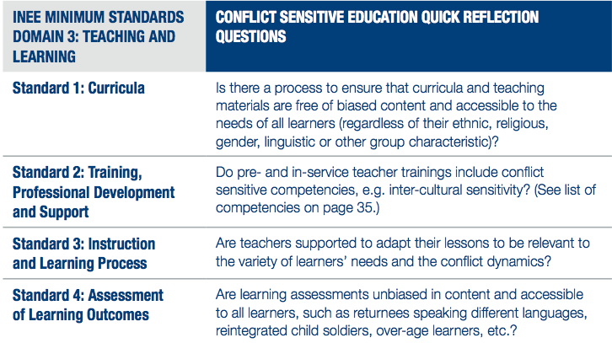
Conflict Sensitive Teaching and Learning Reflection Questions
Notes:
Say: When examining the teaching and learning components of your education program, there are several questions to consider to ensure a conflict sensitive lens has been applied.
Ask for a volunteer from the audience to read each question as it corresponds with each standard. Then ask for addition questions/considerations within that standard.

Slide 10
Conflict Sensitive Strategies for Standard 1: Curricula
Emergency response phase: Discontinue the use of biased materials and instead use of non-formal curricula developed with government and partners (and has MOE approval), analyze existing good practices and opportunities for peace, and train teachers from diverse backgrounds.
Early recovery phase: Train teachers on conflict sensitive competencies such as how to avoid stereotypes in instruction and promote inclusivity. Parents can be involved in modifying existing curriculum to content that is perceived as neutral.
Long-term recovery: Work with government to revise biased content. The planning and curriculum development cycles should include curriculum revision.
Notes:
Say: When examining curricula, there are different considerations for each phase of the conflict.
Early recovery: When first beginning to support education, you have the opportunity to review existing curricula and discontinue the use of any biased materials, and to promote use of good practices that promote peace. This is also the time to bring in teachers from diverse backgrounds and include them in training.
Early recovery: Integrate conflict sensitive competencies to modify existing curriculum
Long-term recovery: Work with government to officially revise biased content in the national curriculum framework. Opportunity to integrate SEL, peacebuilding, etc.
After this slide is reviewed,
Ask: Training and supporting teachers is a large part of what many of us do, can anyone think of conflict sensitive strategies for training, professional development and support?
Answers:
Make teacher training opportunities available to males and females and without discrimination against any group, including refugee and displaced teachers.
For groups who were previously excluded from teacher training, provide relevant supplementary training that meets their needs.
Coordinate with Ministry of Education to ensure the training is recognized for all groups by relevant authorities.

Slide 11
Conflict Sensitive Strategies for Standard 2: Training, Professional Development and Support
For example, if the conflict analysis finds…. | Then consider….
Teacher training centers are located in the south of the country which happens to favor a certain ethnic/language group
Notes:
As a whole group activity
Say: Our conflict analysis can help us identify areas for improvement that need to be considered when designing and implementing our project. For example,
Bullet 3: incentive schemes, establish peer support structures amongst teachers to increase conflict-coping skills, share good practices, and reduce psychosocial stress

Slide 12
Conflict Sensitive Strategies for Standard 2: Training, Professional Development and Support
For example, if the conflict analysis finds…. | Then consider….
Teacher training centers are located in the south of the country which happens to favor a certain ethnic/language group | Working with the government to provide accredited in-service training options through distance learning If possible, offer incentives to underrepresented teachers in remote locations.
Notes:
Bullet 3: incentive schemes, establish peer support structures amongst teachers to increase conflict-coping skills, share good practices, and reduce psychosocial stress

Slide 13
Group Activity
Directions: At your table, work with others to identify possible considerations in response to conflict analysis findings. (5 minutes)
Sharing: Each group will then present the ideas to the whole group. (10 minutes)

Slide 14
Activity
Handout #5: Conflict Sensitive Teaching and Learning
Timing: 20 min. group work, 15 min. to share
Instructions:
In a small group, read the article.
Answer the reflection questions.
Group discussion

Slide 15
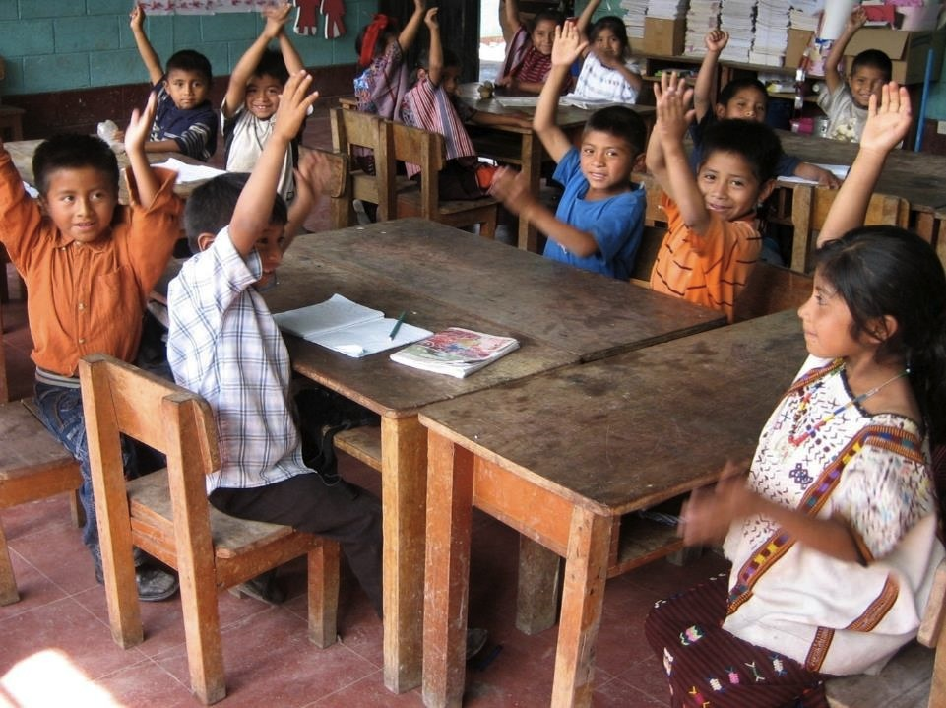
Questions ?

Slide 16
Conflict Sensitive Strategies for Teachers and Education Personnel
Julia Finder, Creative Associates International
Module 6

Slide 17
At the end of this module participants will
Understand how conflict interacts with teacher recruitment, conditions of work and support.
Know conflict sensitive strategies for teacher recruitment, conditions of work and support.
Understand what bias is and know how to avoid it in teacher recruitment.

Slide 18
Notes:
As for volunteers to read each standard.

Slide 19
Small Group Activity
Time: 10 minutes
Instructions:
Form a group of 3.
Pick one of the three standards to focus on.
Discuss how conflict interacts with that standard in your working context.
Notes:
For example, (Standard 1) biased teacher recruitment and selection can lead to grievances of those teachers who are routinely excluded. This could trigger intergroup conflict between those who are excluded and those routinely hired.
(Standard 2) Conflict could disrupt a Ministry of Education’s payroll system so that teachers are not compensated on time.

Slide 20
Conflict Sensitive Strategy for Teacher Supervision
Problem: In Liberia, the undisciplined behavior of teachers is putting children at risk and decreasing the quality of education which is resulting in grievances.
Conflict sensitive solution: Initiate participatory and inclusive development of a teacher code of conduct.

Slide 21
Conflict Sensitive Strategies for Standard 1: Recruitment and Selection
If the conflict analysis finds…
Aid agencies are perpetuating historic discrimination in teacher hiring, causing grievances among locals
Youth in a far eastern province are protesting because of the low quality teachers that are sent to their schools
The emergency response raised educational expectations of previously marginalized groups who had employment opportunities through NGO supported schools which are now not being fulfilled
Notes:
Say: Remember, any response should be informed by conflict analysis.
Aid agencies are perpetuating historic discrimination in teacher hiring, causing grievances among locals (select teachers and personnel based on job descriptions and account for community acceptance, gender, diversity when possible- be mindful of ethnic clan or tribal identity)
Youth in a far Eastern province are protesting because of the low quality teachers that are sent to their schools.
Ask: How could we address these findings in a conflict sensitive way? (provide incentive schemes, provide in-service training, establish coaching and mentoring system with government officials)
The emergency response raised the educational expectations of previously marginalized groups which are not being fulfilled in the transition to development
Ask: What are some strategies that could be used here? (coordinate with MoE, donors, partners to develop HR & payroll system to provide unbiased recruitment and assignment of teachers)

Slide 22
Conflict Sensitive Strategies for Recruitment and Selection
  Teachers and education personnel should…
  Understand the conflict, root causes and dynamics and the need for conflict transformation
  Know education for all is a human right
  Self-awareness of own biases and of how their own actions in/around learning environment may be perceived by different groups in different contexts
  Possess good inter-cultural sensitivity and understanding of learners and families
  Able and willing to have a conversation with learners about conflict
  Able to see the link between equal access to quality education and prevention and mitigation of conflicts
  Able to gather and analyze information in various ways and challenge assumptions

Slide 23
Conflict Sensitive Strategies for Recruitment and Selection
  Partner Activity: Drawing Time!
  What does a good teacher look like?
  Now consider what additional skills does a teacher in a conflict setting need? What do they need to:
Know?
Understand?
Be able to do?
Notes:
Small groups, on flip chart
Gallery walk instead of read out

Slide 24
What is bias?
Notes:
In the absence of information, we fill the gaps with our own (typically negative) assumptions. We can avoid this by:
communicating clearly
2) being aware of our own assumptions and how they influence our thinking and decisions without even intending to.

Slide 25
Defining Bias
  Bias
  Is learned through the socialization process of direct and indirect experiences of others
  Develops into assumptions about the “other”
  Inhibits our ability to be neutral
  Affects the way we work with others
  Can cause or contribute to existing tensions and conflict
Notes:
As we grow up we learn about other cultures through direct contact with these groups and indirect contact through, Internet, newspaper, TV, radio, and other forms of mass media. (Facilitator’s Note: Adapt this list as appropriate for your training context.)
These experiences develop into assumptions about other cultural groups. These assumptions may bias our perception of other cultures and so are known as cultural bias. Culturally biased assumptions fall into two categories:
General bias is assumptions about people who are not from your own background. For example, ‘They’re not like us’.
Bias is assumptions about a particular cultural group. Use an example appropriate for your training context. For example, all Americans eat hamburgers.
It is not only important to recruit teachers who are self-aware of their biases, but also that those doing the recruitment are aware of their biases.

Slide 26
Discussing Bias
Group Discussion
For former teachers in the room, what did you have bias against (if anything)?
Think, Pair, Share:
In your working context, what might teachers have bias against? Learners? Government officials?

Slide 27

Standard 2: Compensation and Working Conditions
Venn diagram: What are conditions of work often like for teachers in conflict-affected areas vs. teachers in stable areas?
Lack of resources
Over crowded classrooms
Hungry learners
Need for PSS/SEL support
Lack of professional development
Notes:
Say: Make a venn diagram with your partner
Teacher motivation is affected by lack of resources
Access to healthcare, childcare

Slide 28
Conflict Sensitive Strategies for Standard 2: Compensation and Conditions of Work
For example, if the conflict analysis finds…
Inequitable teacher compensation for teachers in conflict affected posts
Aid agencies have caused inequities in teacher compensation resulting in government schools teachers leaving to teach in non-formal NGO supported schools
There is no access to healthcare for teachers
Notes:
Inequitable teacher compensation for teachers in conflict affected posts (in-kind compensation: accommodation, food, access to health care)
Aid agencies have caused inequities in teacher compensation resulting in public teacher strikes (provide transparent compensation aligned to local labor market, coordinate with cluster, gov., UN, teachers unions to agree on common rate)
There is not access to healthcare to the area (layer education intervention with a health intervention- cross sectoral collaboration and integration)
Say: It is important to keep in mind that sometimes the solution to an education problem isn’t an education solution, rather it needs to be

Slide 29
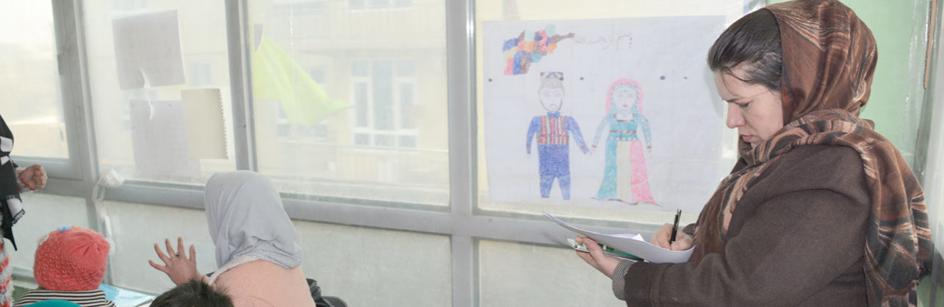
Afghanistan Example
In Afghanistan, the government has integrated community-based schools, students, and teachers into government system and payroll.

Slide 30
Standard 3: Support and Supervision
Think, Pair, Share (5 minutes)
How is teacher support and supervision affected by conflict? Consider both the positive and the negative impact.
Notes:
For example: UNESCO was asked to conduct a research to compare learning outcomes of students in IDP camps with those in government schools in Juba, South Sudan. Using adapted EGRA and EGMA tools, the results of the study indicated that students learning in unofficial schools in the IDP camps performed significantly higher on both math and reading than students in the public government schools. Based on interviews and FGDs, it was determined that the reason for such startling discrepancies in learning outcomes could be attributed to increased professional support through training, timely compensation, and provision of resources that teachers in the IDP camp received.

Slide 31
Conflict Sensitive Strategies for Standard 3: Support and Supervision
Technical support to teachers in hardship posts
(teacher learning circles, providing professional development, access to in-service certification programs, PSS/SEL for teacher well-being)
Community accountability mechanisms
(remote supervision strategies using technology with geotracking, training up PTA and SBMC to be accountable)

Slide 32
Activity
Handout #6: Conflict Sensitive Practices for Teachers and Other Education Personnel
Timing: 35 min individual and pair work, 10 min. discussion
Instructions:
Working on your own, explore how effective you are at promoting a bias free education environment by answering the following questions.
When you are finished, find a partner to discuss your reflections. You may use the following questions as a guide for your discussion.
  How did your perception of your own bias change after finishing the activity?
  How could a tool like this be useful in your work when working with government to support teacher recruitment, selection or supervision policies?
  Why is it important for both recruiters and those being recruited to be aware of bias?
  What changes would you make to the tool to adapt it to your own context?

Slide 33
Review
Give one example of a conflict sensitive competency?
Explain how teacher compensation practices could lead to conflict.
Describe a conflict sensitive strategy for teacher recruitment and selection.
How might bias teacher recruitment lead to conflict?

Slide 34
Questions ?

Slide 35
Conflict Sensitive Strategies for
Domain 5: Education Policy
Nina Weisenhorn, USAID
Module 7

Slide 36
At the end of this module participants will:
Understand how conflict interacts with education policy and law.
Be familiar with the international documents that support the right to education and the INEE CSE Guiding Principles.
Know conflict sensitive strategies for Domain 5: Education Policy based on findings of a conflict analysis.

Slide 38
Interaction between teachers/personnel and conflict
Education Policy
Formulation
Implementation
Conflict

Slide 39
Domain 1: Law and Policy Formulation
If the conflict analysis finds…
Decentralization of education led marginalized populations to perceive they have received less power and resource than the others
During the conflict a variety of non-formal learning centers were set up by non-state actors with varying degrees of quality. This has lead to frustration by community groups and the government who has no oversight of them.
Displaced populations want to be taught in their home curriculum, but neither the host government nor their home government will certify their learning
After the civil war, which was largely divided along ethnic lines, the Ministry of Education has instituted a policy on the use of English as the language of instruction so as to avoid exaccerbating inter-ethnic tensions
Notes:
Consider revising policies.
Accreditation of non-formal learning centers that were set up by non-state actors (NGOs, private, CBE)
Certification of learning of displaced populations
Language of instruction policy
Decentralization of education systesm

Slide 40
Activity
Time: 5 minutes
Instructions:
Below are some acronyms of the legal documents that protect or support the right to education for all including in contexts of conflict. UNDHR, ICCPR, CEDAW, ICESCR, CRSR, UNSCR 1998, CRRF, Global Compacts GCPEA, others?
Write down as many of the document titles as you can think of.
(Hint: you may find some answers in the INEE Guidance Note on Conflict Sensitive Education.)
Notes:
There are also an emerging number of global compacts and frameworks that are helping to support inclusion of refugees in host country education systems:
CRRF
Global Compact (e.g. Lebanon and Jordan pilots)
GCPEA

Slide 41
Acronym Quiz!
SDG
GCPEA
EFA
CEDAW
CRPR
CRC
UNSCR 1998
UNDHR
Notes:
CEDAW = Convention on the Elimination of all forms of Discrimination Against Women
Convention on the Right of Persons with Disabilities
UNSCR 1998 – protection of children in armed conflict, declaring schools and hospitals off limits for armed groups and military activities, making them ’grave violations’ against children

Slide 42
Domain 1: Law and Policy Formulation
Educational law should…
Be aligned with human rights and international law
Ensure provision of and access to education without discrimination (including for refugees)
Reflect international law regarding the right to, and protection of, education in times of conflict
Be backed by accountability measures

Slide 43
Conflict Sensitive Strategies for Policy Formulation
Use equity as a guiding principle of formulation
  Use a process that is inclusive and fosters social cohesion
  Respond to multi-stakeholder demands
  Inform policies by disaggregated data on budget allocations, enrolments, and teacher deployments
Ensure smooth transitions from short to long term policies

Slide 44
Domain 2: Planning and Implementation
Enforce equitable implementation in all regions
Continue participatory and inclusive dialogue
Integrate with other national strategies

Slide 45
Domain 2: Planning and Implementation
Build state’s capacity to monitor and regulate non-government education providers
Plan education targets and resource inputs with consideration for equity
Monitor continuously
Notes:
Provide example of Lebanon non-formal education

Slide 46

Reflection Tool
To assess, monitor or evaluate a programme.
Guiding Principles
To raise awareness and adopt as standards of practice.
Guidance Note
To build capacity on key concepts and strategies.

Slide 47
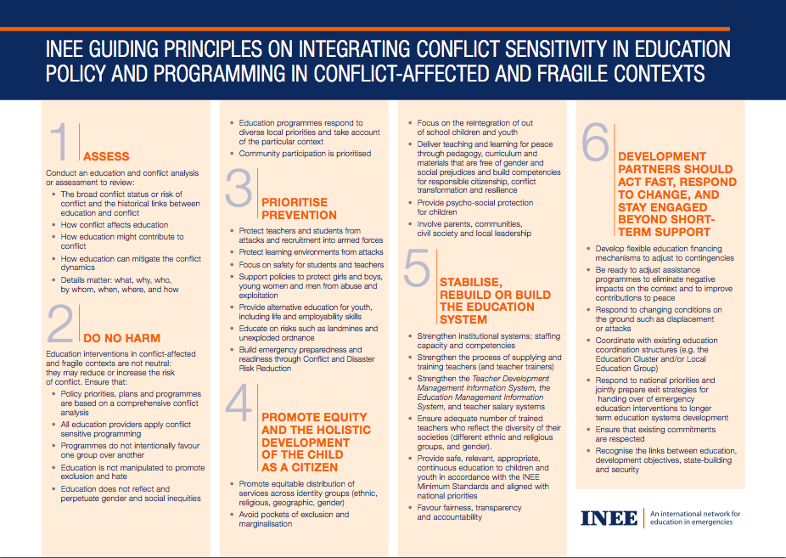
INEE CSE Pack
Guiding Principles

Slide 48
Activity
Handout #7B Conflict Sensitive Practices for Education Policy Formulation and Implementation
Time: 45 minutes activity, 15 minutes presentation and discussion
Instructions:
Role-play as members of the Local Education Group.
Choose one of the six INEE CSE Guiding Principles.
Write a 2-minute advocacy speech to give at your next LEG meeting about the Principle.
Include in your speech:
  a) What the INEE Guiding Principles for Conflict Sensitive Education are;
  b) Why the selected principle is important, and
  c) How (specific actions) the MOE could implement this principle.
Notes:
--- find some policies (inclusive ed, refugee integration, national gender policy, XXX)
-- how would you ensure implementation of this policy in a conflict sensitive way

Slide 49
Review
What is one international legal document that supports the right to education for all?
What is one conflict sensitive strategy to education policy formulation or implementation?
What is one way you could use the INEE Conflict Sensitive Education Guiding Principles?

Slide 50
Questions ?

Slide 51
Conflict Sensitive Monitoring, Evaluation and Learning
Anne Smiley, FHI 360
Module 8

Slide 52
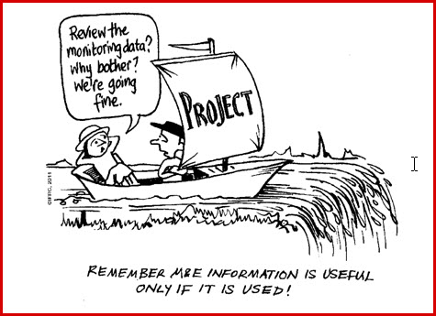

Slide 53
At the end of this module participants will:
Understand how monitoring, evaluation and learning and conflict interact.
Know the 3 parts to conflict sensitive monitoring, evaluation and learning.
Be able to apply the INEE CSE Pack Reflection Tool.

Slide 54
How does conflict interact with monitoring, evaluation and learning activities?
Education Monitoring, Evaluation and Learning
Conflict

Slide 55
3 Parts to Conflict Sensitive MEL
MEL activities can exacerbate conflict or contribute to peacebuilding
ASK: What does it take for the program’s MEL system to be conflict-sensitive?
Conflict dynamics are always changing and a conflict analysis can’t be a one-time deal.
ASK: How does the MEL system assess changing contextual conditions and work with program management to adapt?
Programs need to be reviewed and evaluated periodically, and adjustments made.
ASK: How conflict sensitive is the program? What actions can be taken to improve conflict-sensitivity?
SOLUTION: Move beyond output indicators; design the M&E system in response to the findings from the conflict analysis/RERA
SOLUTION: RERA followed by Rolling Assessments of the changing conditions; adaptive management
SOLUTION: Use the INEE Reflection Tool, USAID conflict sensitivity checklist
1
3
2

Slide 56
Part 1: What does it take for the program’s MEL system to be conflict-sensitive?

Slide 57
Moving beyond output indicators
Output data does not tell us much about whether or not we are doing harm
To the extent possible and relevant, measure:
  Safety of learning environments
  Equitable access to educational services
  Conflict-sensitivity of the program
  Adaptive management
  And more???
Use the learning to constantly improve the program

Slide 58
Being conflict sensitive when we collect data
Whose perspectives do we need to hear?
How should we reach those people?
How will the data collectors be perceived by the people being consulted?
Will people feel safe to speak?
Will people become angry when reflecting on our questions?

Slide 59
Being conflict sensitive when we analyze data
Triangulation
comparing information gathered across different sources
Outliers
Disaggregation
separating information according to different characteristics
Validation
presentation of information to people familiar with the issues in order to elicit their feedback on accuracy

Slide 60
3 Parts to Conflict Sensitive MEL
MEL activities can exacerbate conflict or contribute to peacebuilding
ASK: What does it take for the program’s MEL system to be conflict-sensitive?
Conflict dynamics are always changing and a conflict analysis can’t be a one-time deal.
ASK: How does the MEL system assess changing contextual conditions and work with program management to adapt?
Programs need to be reviewed and evaluated periodically, and adjustments made.
ASK: How conflict sensitive is the program? What actions can be taken to improve conflict-sensitivity?
SOLUTION: Move beyond output indicators; design the M&E system in response to the findings from the conflict analysis/RERA
SOLUTION: RERA followed by Rolling Assessments of the changing conditions; adaptive management
SOLUTION: Use the INEE Reflection Tool, USAID conflict sensitivity checklist
1
3
2

Slide 61
Part 2: How does the MEL system assess changing contextual conditions and work with program management to adapt?

Slide 62
Keeping the conflict analysis live through rolling assessments
Rolling Assessments of key contextual factors
Adaptive Management Approaches
Conflict Analysis

Slide 63

Rolling Assessments
Build on the conflict analysis (i.e. RERA) findings to monitor key contextual factors
How often? Frequency of monitoring depends on the pace of change in any context
Coordinate/collaborate with other actors working in the area to share contextual data
Build monitoring tools into programmatic activities

Slide 64

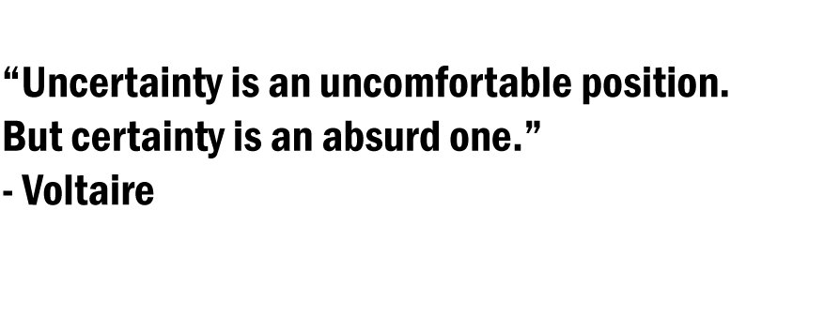
Adaptive Management

Slide 65
Adaptive Management
Scenario mapping ahead of program implementation
Feedback Loops drawing on the MEL System to test Theories of Change (TOC), Learn, and Adapt
  Use dashboards, data visualizations to capture early outcomes and contextual changes
  Analysis and discussion of data and learning, incorporating the insights of front-line workers
  Form action plans on what needs to be done differently, including revised TOC and setting new targets
  Implementing action plans and continuing to adapt as needed

Slide 66
3 Parts to Conflict Sensitive MEL
MEL activities can exacerbate conflict or contribute to peacebuilding
ASK: What does it take for the program’s MEL system to be conflict-sensitive?
Conflict dynamics are always changing and a conflict analysis can’t be a one-time deal.
ASK: How does the MEL system assess changing contextual conditions and work with program management to adapt?
Programs need to be reviewed and evaluated periodically, and adjustments made.
ASK: How conflict sensitive is the program? What actions can be taken to improve conflict-sensitivity?
SOLUTION: Move beyond output indicators; design the M&E system in response to the findings from the conflict analysis/RERA
SOLUTION: RERA followed by Rolling Assessments of the changing conditions; adaptive management
SOLUTION: Use the INEE Reflection Tool, USAID conflict sensitivity checklist
1
3
2

Slide 67
Part 3: How conflict sensitive is the program? What actions can be taken to improve conflict-sensitivity?

Slide 68
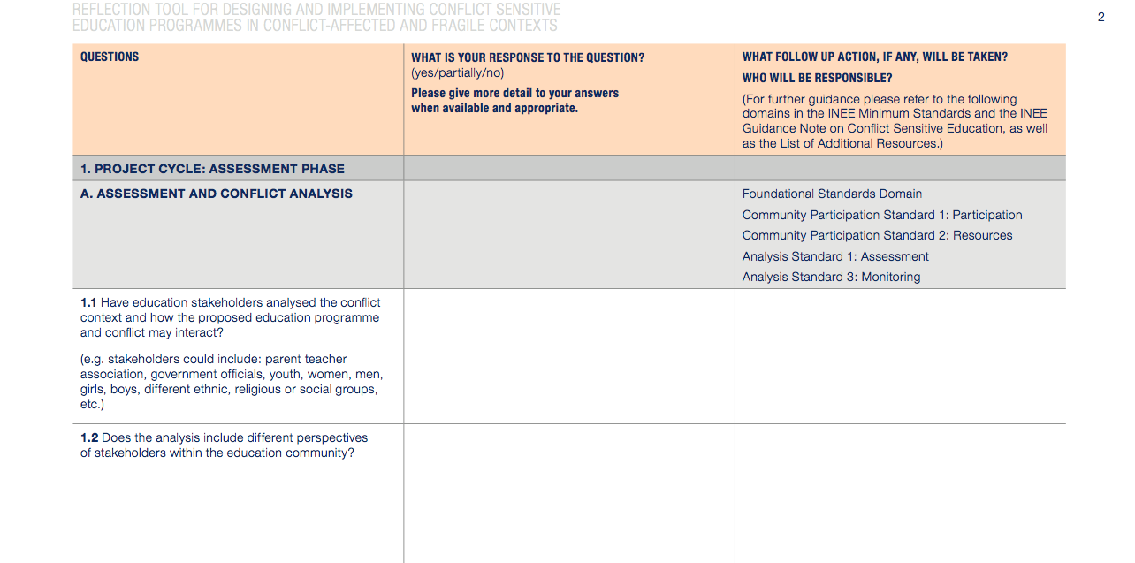
INEE CSE Pack Reflection Tool
Questions
Your Responses
Follow-up and References

Slide 69
Activity
Timing: 15 min. individual work, 15 min. discussion
Instructions:
Take out the Reflection Tool from your participant packet and your Guidance Note.
Think of your project and consider what part of the Reflection Tool is most relevant/interesting.
Do steps 1-4 of the ‘How to Use This Tool’.
Write your answers on your own copy of the Reflection Tool.

Slide 70
Discussion
How did it feel to use this tool on a project you are familiar with?
How would you consider changing your project based on this exercise? What challenges might you encounter in trying to enact change?
Did anything surprise you about this process? Did the questions cause you to challenge any implicit biases or assumptions?

Slide 71
Review
List the three parts of conflict sensitive monitoring and evaluation
  What does it take for the program’s MEL system to be conflict-sensitive?
  How does the MEL system assess changing contextual conditions and work with program management to respond accordingly?
  How conflict sensitive is the program? What actions can be taken to improve conflict-sensitivity?

Slide 72
Questions ?

