Slide 1
Book Supply Chain Training Module 2:
Title Development

Slide 2
SESSION 1: Introductions and Training Objectives
Objectives
Outline key administrative matters and the agenda for the workshop
Articulate the shared ground rules for behavior during the workshop
Share the objectives for the training
2

Slide 3
Activity 1.1 – Partner Introductions
3

Slide 4
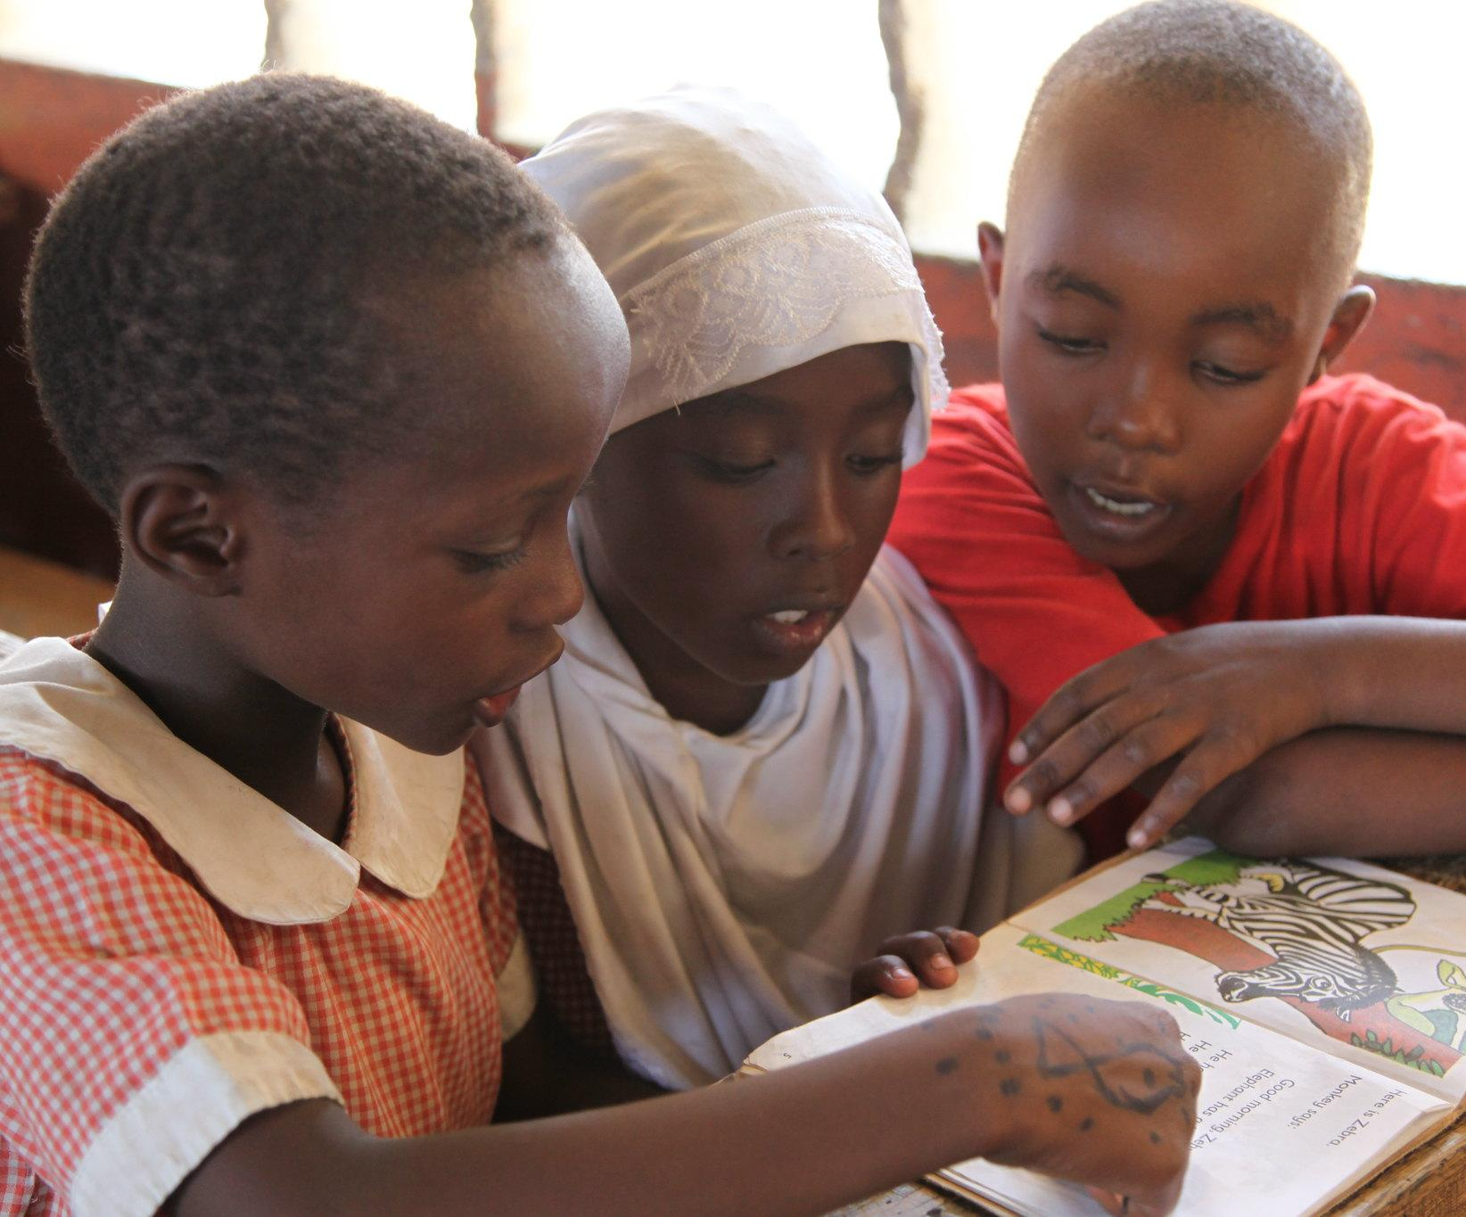
Administrative Matters & Logistics
4

Slide 5
Sample Training Agenda
TIME | ACTIVITY
9:00 a.m. – 9:30 a.m. | 1. Introductions and Training Objectives (30 mins)
9:30 a.m. – 10:05 a.m. | 2. Introduction to Title Development (35 mins)
10:05 a.m. – 10:45 a.m. | 3. Characteristics of High-Quality Books for Children (40 mins)
10:45 a.m. – 12:30 p.m. | 4. Identifying the Right Books for the Right Level (45 mins)
12:30 p.m. – 1:40 p.m. | 5. Principles of Children’s Book Design/Illustration Sourcing (40 mins)
12:40 p.m. – 1:40 p.m. | 6. Project Management of a Book Project (60 mins)
1:40 p.m. – 2:15 p.m. | 7. Wrap up and Reflection on the Workshop (35 mins)
5

Slide 6
Ground Rules and Expectations
No side conversations.
Telephones must be silenced.
Participants and trainers all have the responsibility of ensuring that sessions begin and end on time.
Respect the viewpoints of others and allow everyone the chance to speak. Remind those who like to participate to allow more reserved members to provide their feedback.
6

Slide 7
Activity 1.2 – Sharing Expectations
7

Slide 8
Training Objectives
By the end of this module, participants will be able to:
Identify high-quality books for children.
Understand the development process of a children’s book.
8

Slide 9
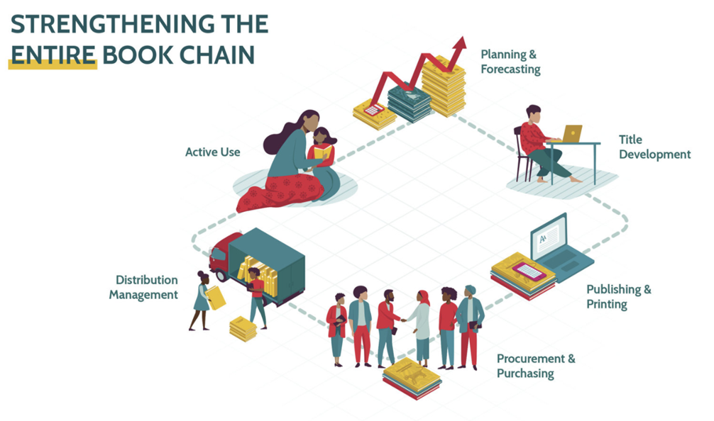
Supplementary Activity
https://youtu.be/9XMkNnaaBZ8
9
Notes:
https://youtu.be/9XMkNnaaBZ8

Slide 10
SESSION 2: Introduction to Title Development
Objectives
Identify the principal actors in publishing a children’s book
Understand the main steps in the title development process
Understand the particular requirements for creating leveled and decodable readers
10

Slide 11
Title Development
From manuscript through final PDFs sent to printer
Expertise needed:
Pedagogical knowledge
Writing
Editing
Graphic design
Illustration
Page layout
11

Slide 12
Actors
Private Publishers
Donors, NGOs
Ministries of Education
12

Slide 13
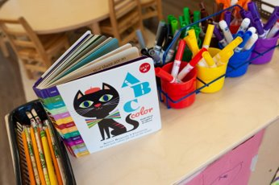
Steps in the Title Development Process
Planning, writing and editorial
Substantive (developmental) editing
Copyediting
Graphic design
Illustrations
Page layout and proofreading
13

Slide 14
Software Platforms for Book Development
Allow writers and illustrators to create content and mount it directly onto the platform under an open license.​
Help authors create linguistically-correct decodable and leveled reading materials. ​
Creation done online or offline​.
Typically free to use, and outputs include print-ready PDFs and EPUBs​.
Used in workshops to create titles suitable for specific learning levels​.
Can be set up to allow the creation of materials in multiple local languages​.
14

Slide 15
Digital Resources for Book Development
StoryWeaver
African Storybook
Bloom Library
SIL Lead
15

Slide 16
Activity 2.1 – Peer Sharing
16

Slide 17
Activity 2.1 - Instructions
Read the manuscript for The Great Hairy Khyaa
Questions:
Is this book aimed for emergent readers? Or more fluent?
What kind of editing does this manuscript need?
What overall style should the book convey through its illustrations? (Serious? Comical? Whimsical?)
17

Slide 18
SESSION 3: Characteristics of High-Quality Books for Children
Objectives
Identify five characteristics that define high quality children’s books: language, content, diversity, illustrations, and design

Slide 19
What Makes a Good Children's Book
Books are essential for learning to read.
Children need a variety of books at different stages.
Books allow children to practice emergent literacy skills.
Decodables, leveled readers, and supplementary reading materials are all important.
Books should be fiction and non-fiction.
Books for children must be engaging, relevant, and written at the right level.
Books must be available in languages children use and understand.
What was your favorite book as a child?
19

Slide 20
Activity 3.1 – Read Aloud
20

Slide 21
Activity 3.1 – Read Aloud (2)
Listen to the Read Aloud considering the story and illustrations. Be prepared to discuss the following questions:
What did you like about the book?
What made the book interesting to listen to?
What did you think about the plot?
What did you think about the illustrations?
How are you similar to the characters in this book? How are you different?
Do you think children could relate to the characters in this book? Why or why not?
21

Slide 22
Elements of Quality in Children’s Books
Content
Diversity
Language
Illustrations
Design
22

Slide 23
Content
Topic and Theme
Plot
Setting
Characterization
Genre
23

Slide 24
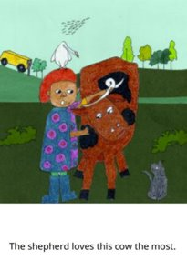
Diversity and Equity
Diverse story books promote mutual understanding, empathy, and celebrate differences
‘Mirror’ and ‘window’ stories
Variety in setting and characters
Not stereotypical
Help children see different perspectives
24

Slide 25
Illustrations
Varied illustrations: realistic, cartoons, paintings
Like obvious emotion and playful characters
Like images that are relatable
Correct positioning improves comprehension
One illustration per page
Use of perspective
25

Slide 26
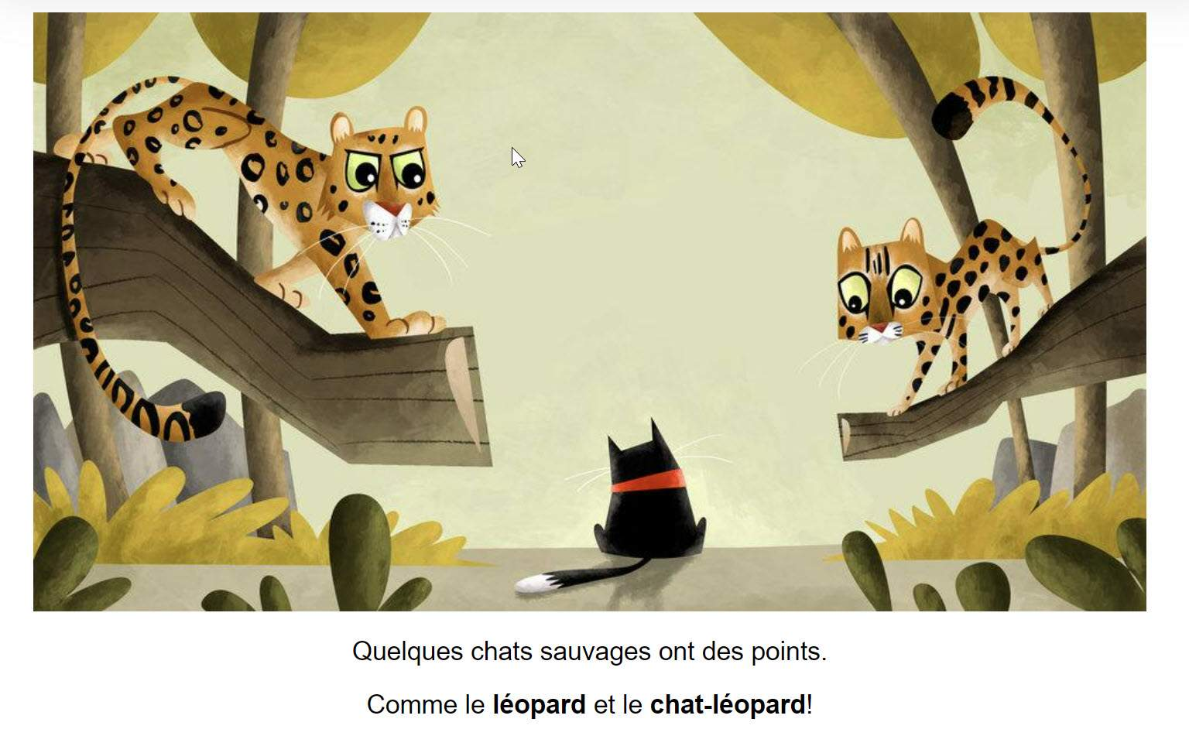
Design
Well-designed books are more visually appealing.
Good design helps with reading and understanding text.
Sans serif fonts, spacing and font size are helpful for younger readers.
26

Slide 27
Activity 3.2 – Identifying Elements of Quality in Children’s Books
27

Slide 28
Activity 3.2- Instructions
Read Magozwe by Lesley Koyi (or other book from the Global Digital Library) as a group or in small groups.
While the book is being read, have participants take notes on the specific ways that the book includes the five elements of quality discussed earlier. The group will have 10 minutes to discuss.
Language
Content
Diversity
Illustrations
Design
28

Slide 29
SESSION 4: Identifying the Right Books for the Right Reading Level
Objectives
Articulate why a class library should have books across reading levels
Identify different types of books from decodables to leveled readers and the process of moving between these books

Slide 30
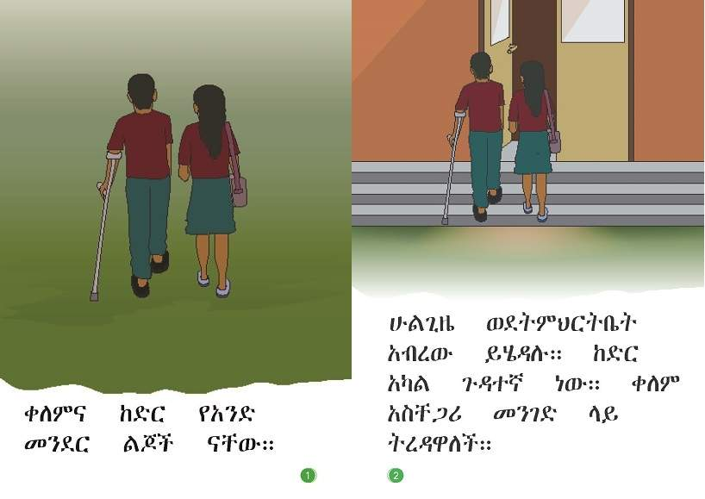
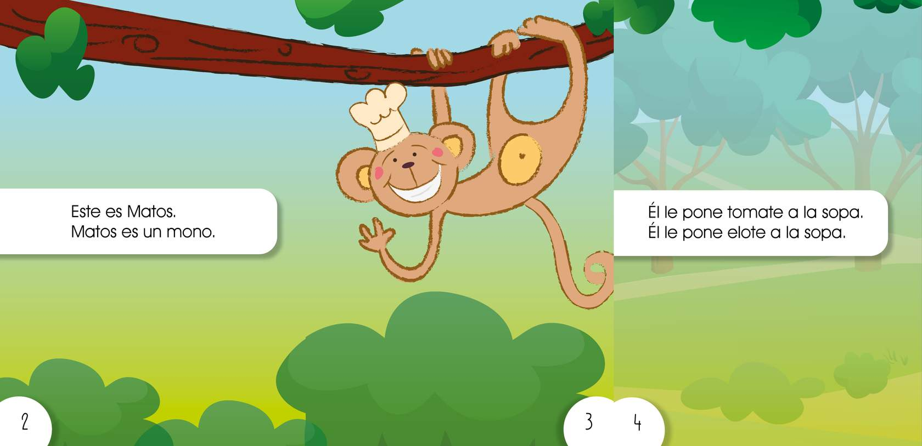
Decodable Readers
Linked to the instructional curriculum and the scope and sequence of letter-sound instruction in the early grades
Example of decodable reader in Amharic
Example of decodable reader in Spanish
30

Slide 31
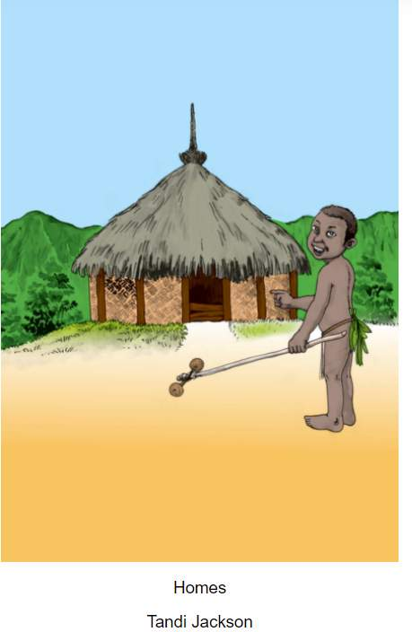
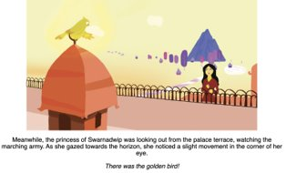
Leveled Readers
Books or stories with increasing levels of difficulty that use a subjective criteria to range from very simple (level 1) to gradually more complex and challenging (levels 7-10)
Example 1: Homes - Global Digital Library by Tandi Jackson (Level 1)
Example 2: The Golden Bird by Alisha Berger (Level 4)
31

Slide 32
Leveled Readers (2)
Level | Vocabulary | Print | Predictability | Illustrations | Content and Concepts
1 | 0-2 words per page • Key early sight words | Large print found in the same place on every page • Short book | No rhythm or pattern | Simple, clear, no clutter • Provide strong, direct support for text | No story line • Labeling of pictures of familiar objects and actions
2 | Simple, familiar language • Some sight words repeated in the text pattern | Consistent placement of print • Short length | Usually a consistent pattern that may change slightly at the beginning or end of the book | Text is usually labeling of pictures • Very strong picture support for text | Familiar objects or actions • No evident story line
3 | Increased number of sight words • Mostly decodable words | 1 to 3 sentences per page, require reader to make a return sweep | Similar to Level 4 at first, but ending may be completely different pattern • May have 2-3 pattern changes | Still high support for text • Familiar objects and actions | Starting of simple story line • May have more than one character talking
4 | More unique words introduced per page, but still dominated by high frequency words. • New vocabulary repeated often | Longer stories, more words per page | Sentence pattern still apparent, but doesn’t dominate text • Lots of repeated text • Highly predictable | More detailed, less supportive of text | More sophisticated sequence of events • Single event continues over several pages with a variation in sentence patterns
32

Slide 33
Activity 4.1 –Reviewing Decodable and Leveled Readers
33

Slide 34
Activity 4.1 - Instructions
Place participants in two groups and have them do the following
Read through the headings on the Flyleaf Publishing page
How many different ‘types’ of decodables are there? How are the decodables organized?
Choose a book from Part 1-Emergent Reader Series. Read through the book.
What letter-sounds are being taught? What high frequency words do you notice? Turn to the last page and read through the explanation of the target letter-sounds being taught. Did you come to the same conclusion?
Choose a book from Part 2-CCVCC Word (Blends). Answer the same questions as above.
Choose a book from Part 4-Multisyllabic words.
What letter-sounds are being taught? What high frequency words do you notice? Turn to the last page and read through the explanation of the target letter-sounds being taught. What is different about this book compared to the books in Parts 1 and 2?
34

Slide 35
When to Use Different Book Types
Move from decodable texts to leveled readers when:
Learners have mastered high frequency words taught by teacher.
Learners have mastered phonics patterns taught by teacher.
Learners can read multisyllabic words in isolation.
Learners have practiced reading all decodable texts available in the classroom.
Learners are confident reading decodable texts independently.
35

Slide 36
5 Finger Rule
36

Slide 37
Activity 4.2 – Thoughts and Reflections
37

Slide 38
Activity 4.2 - Instructions
On a piece of paper, complete the following sentences:
I have learned that …
I still have a question about …
38

Slide 39
SESSION 5: Principles of Children’s Book Design/Illustration Sourcing
Objectives
Describe the basic elements of graphic design and how graphic design contributes to a quality book
Articulate best practices in graphic design, as applied to essential reading materials
Describe types of illustrations and art resources for children’s books
39

Slide 40
General Children’s Books: Specifications
Trim size | There are some standard trim sizes for children’s books, among them 8” x 10” and 7” x 10” in the U.S. (trim sizes will differ elsewhere). It is generally advisable to use trim size that is standard in the local context, for cost effective printing. Orientation can be considered too (portrait versus landscape).
Number of pages | The number of pages must be in a multiple of 4. Many children’s books are either 24 or 32 pages long.
Number of words per pages | If a manuscript is already written, the designer thinks about how much text will appear on each page, and how the text will break from one page to the next. In other instances, s/he may work with the writer to look at each page and determine the amount of text to be placed on it.
Fonts | For early readers, it is important to choose a font with regular letter forms. Research has shown that sans serif types work best for young readers.
Color | Generally, a black and white book is less expensive, but color adds interest and has been shown to motivate young readers.
Illustration style | The designer thinks about what illustrations will be best suited to the text. The minimum image resolution for both storybooks and story cards is 300 DPI.
40

Slide 41
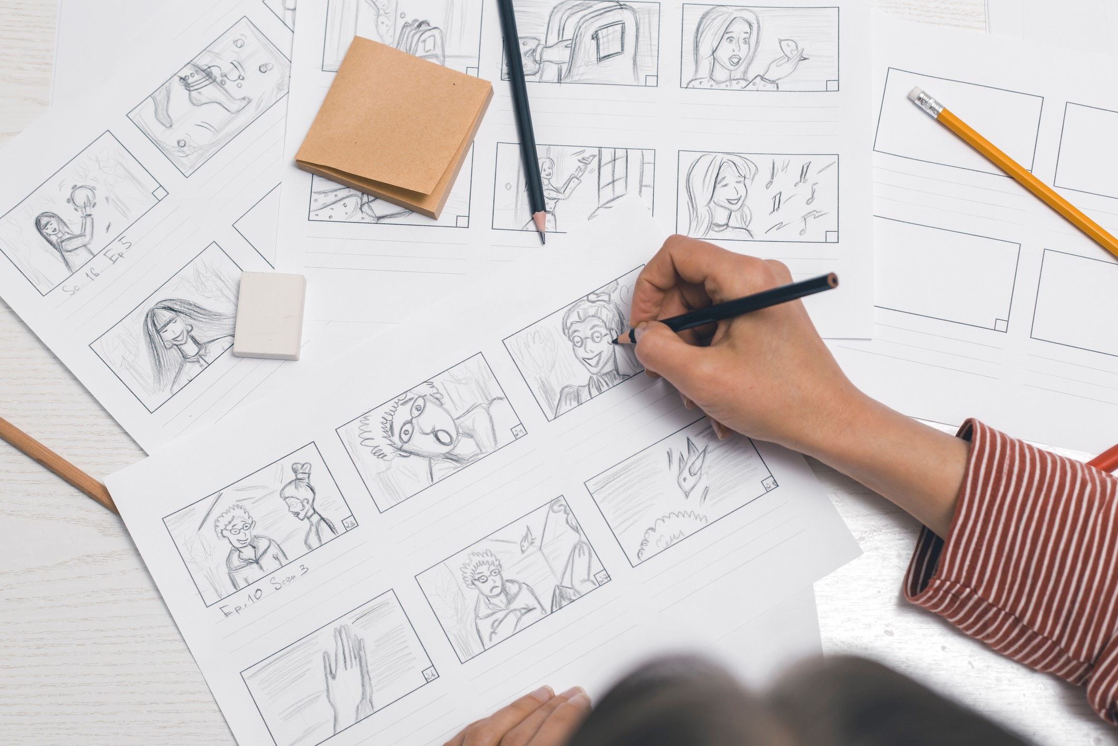
Storyboard
41

Slide 42
Decodable and Leveled Readers: Specifications
Fonts | Use a sans serif font, like Andika. Font size differs depending on Grade level, but generally use around 28-30 pts for Grade 1, and 24-26 pts for Grade 3 (for English/Latin script). A b c d e f
Sentence length | Sentences in both leveled and decodable readers should be fairly short. For leveled readers, sentence length increase as the reader moves up in levels.
Number of pages | Decodable Readers tend to be short, between 12-16 pages in length.
Color | Do not use too much color on the page, especially behind text, as it could distract a young reader.
Illustrations | Decodable Readers have few illustrations, as they are designed so that the student must rely only on their decoding skills to read, rather than guessing through context.
Spacing | Space around letters and words, between lines as well as the space below titles and around illustrations should be carefully considered. Each paragraph should be separated by four lines, and six line spaces should separate headings/titles from the body of the text. Text should not be justified.
42

Slide 43
Example of a Pupil Book
43

Slide 44
Activity 5.1 – Evaluating Graphic Design Elements
44

Slide 45
Activity 5.1 – Evaluating Graphic Design Elements (2)
Read 1 or 2 books and evaluate how the design supports different levels of readers.
Print​ | Predictability​ | Illustrations​ | Content ​
Large print found in the same place on every page • Short book​ | No rhythm or pattern​ | Simple, clear, no clutter • Provide strong, direct support for text ​ | No story line ​ • Labeling of pictures of familiar objects and actions ​
Consistent placement of print • Short length​ | Usually, a consistent pattern that may change slightly at the beginning or end of the book​ | Text is usually labeling of pictures • Very strong picture support for text​ | Familiar objects or actions • No evident story line​
1 to 3 sentences per page, require reader to make a return sweep ​ | Like Level 4 at first, but ending may be completely different pattern • May have 2-3 pattern changes​ | Still high support for text • Familiar objects and actions​ | Starting of simple story line • May have more than one character talking​
Longer stories, more words per page​ | Sentence pattern still apparent, but doesn’t dominate text • Lots of repeated text • Highly predictable​ | More detailed, less supportive of text​ | More sophisticated sequence of events • Single event continues over several pages with a variation in sentence patterns​
45

Slide 46
Illustration Sourcing
Writer as illustrator
Commissioned illustrator
Online copyright-free images
Illustration Workshops
46

Slide 47
Spot Illustrations
47

Slide 48
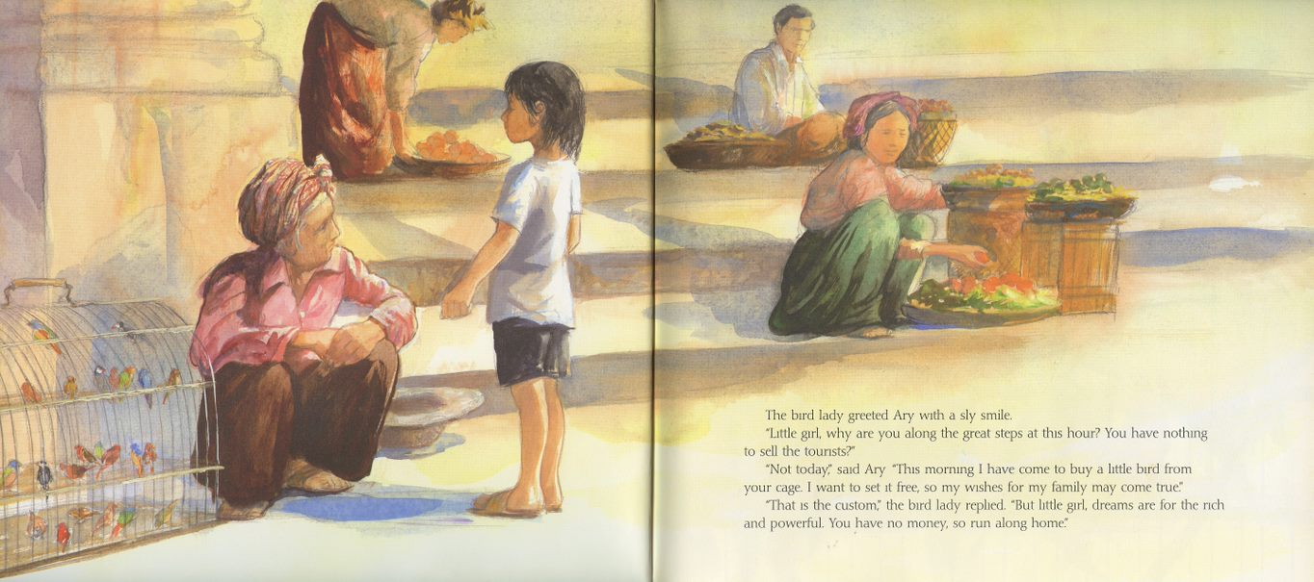
Page Layout
48

Slide 49
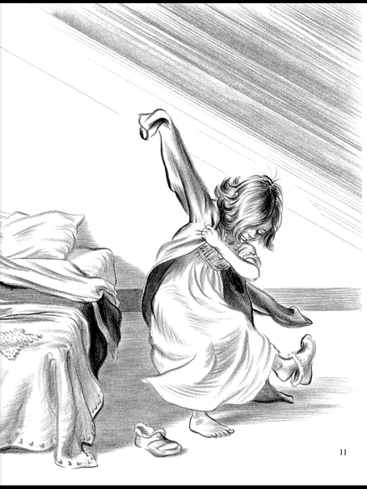
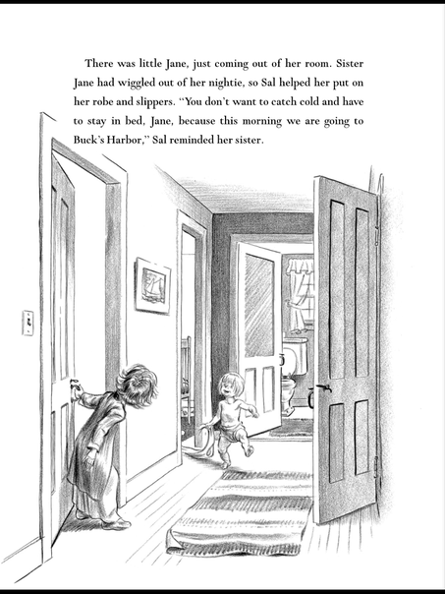
Illustration Style: Vintage
49

Slide 50
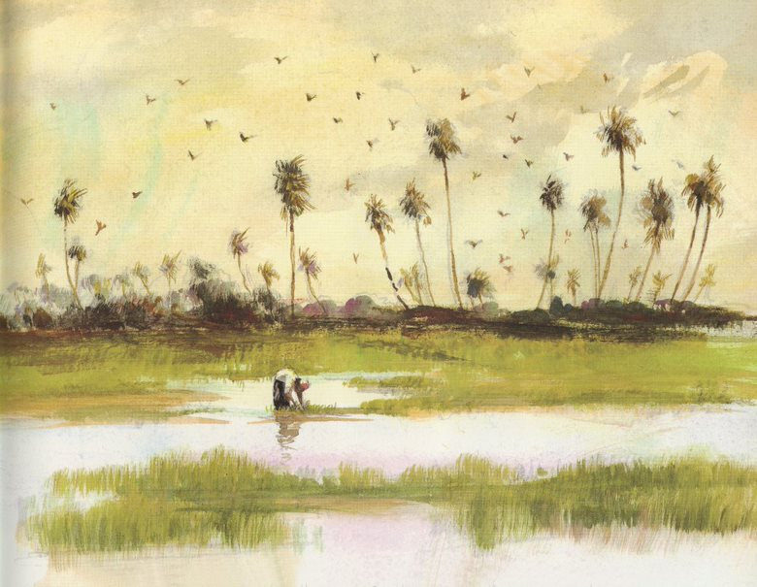
Artistic and Evocative
50

Slide 51
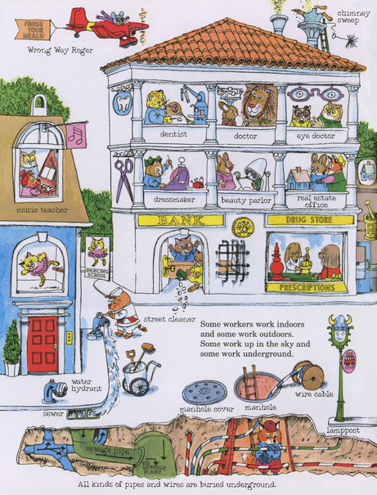
Detailed, Cartoon Style
51
Notes:
Image is copyrighted by Penguin Random House and may not be printed or distributed without permission.

Slide 52
Comical
52

Slide 53
Frightening
53

Slide 54
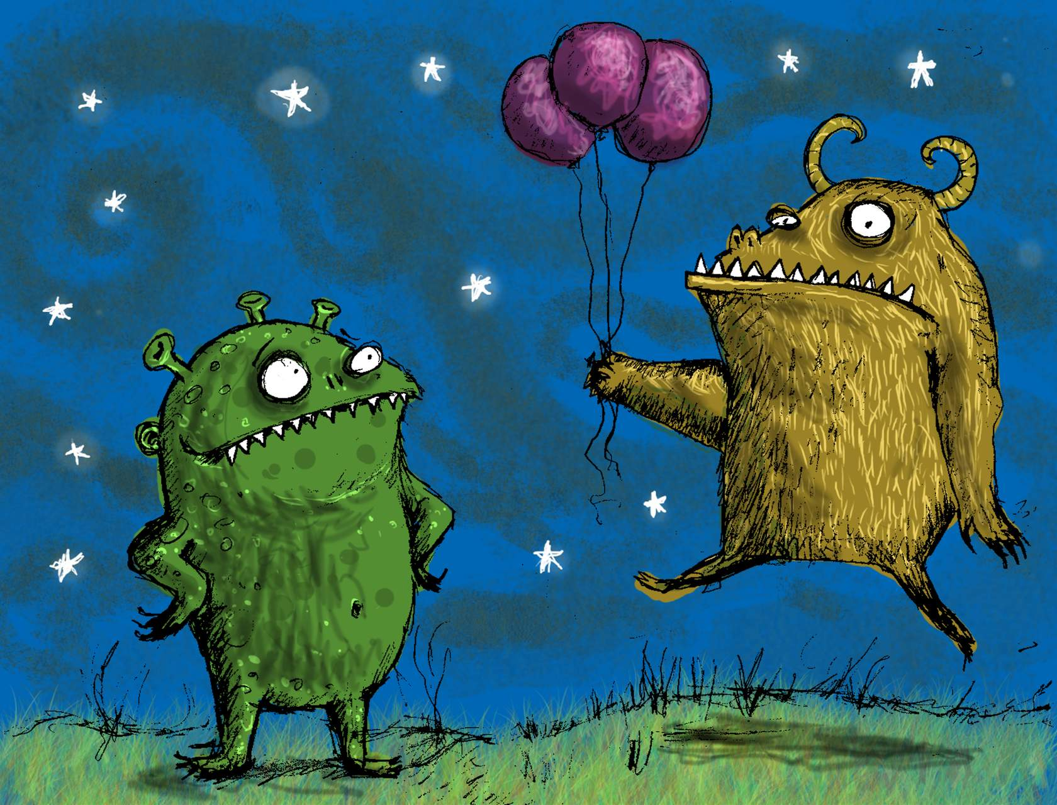
Comical AND Frightening
54

Slide 55
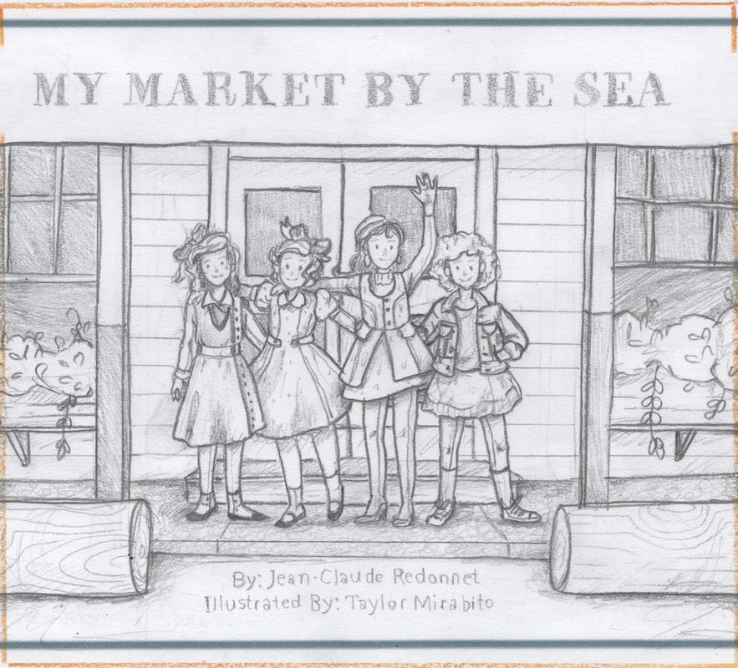
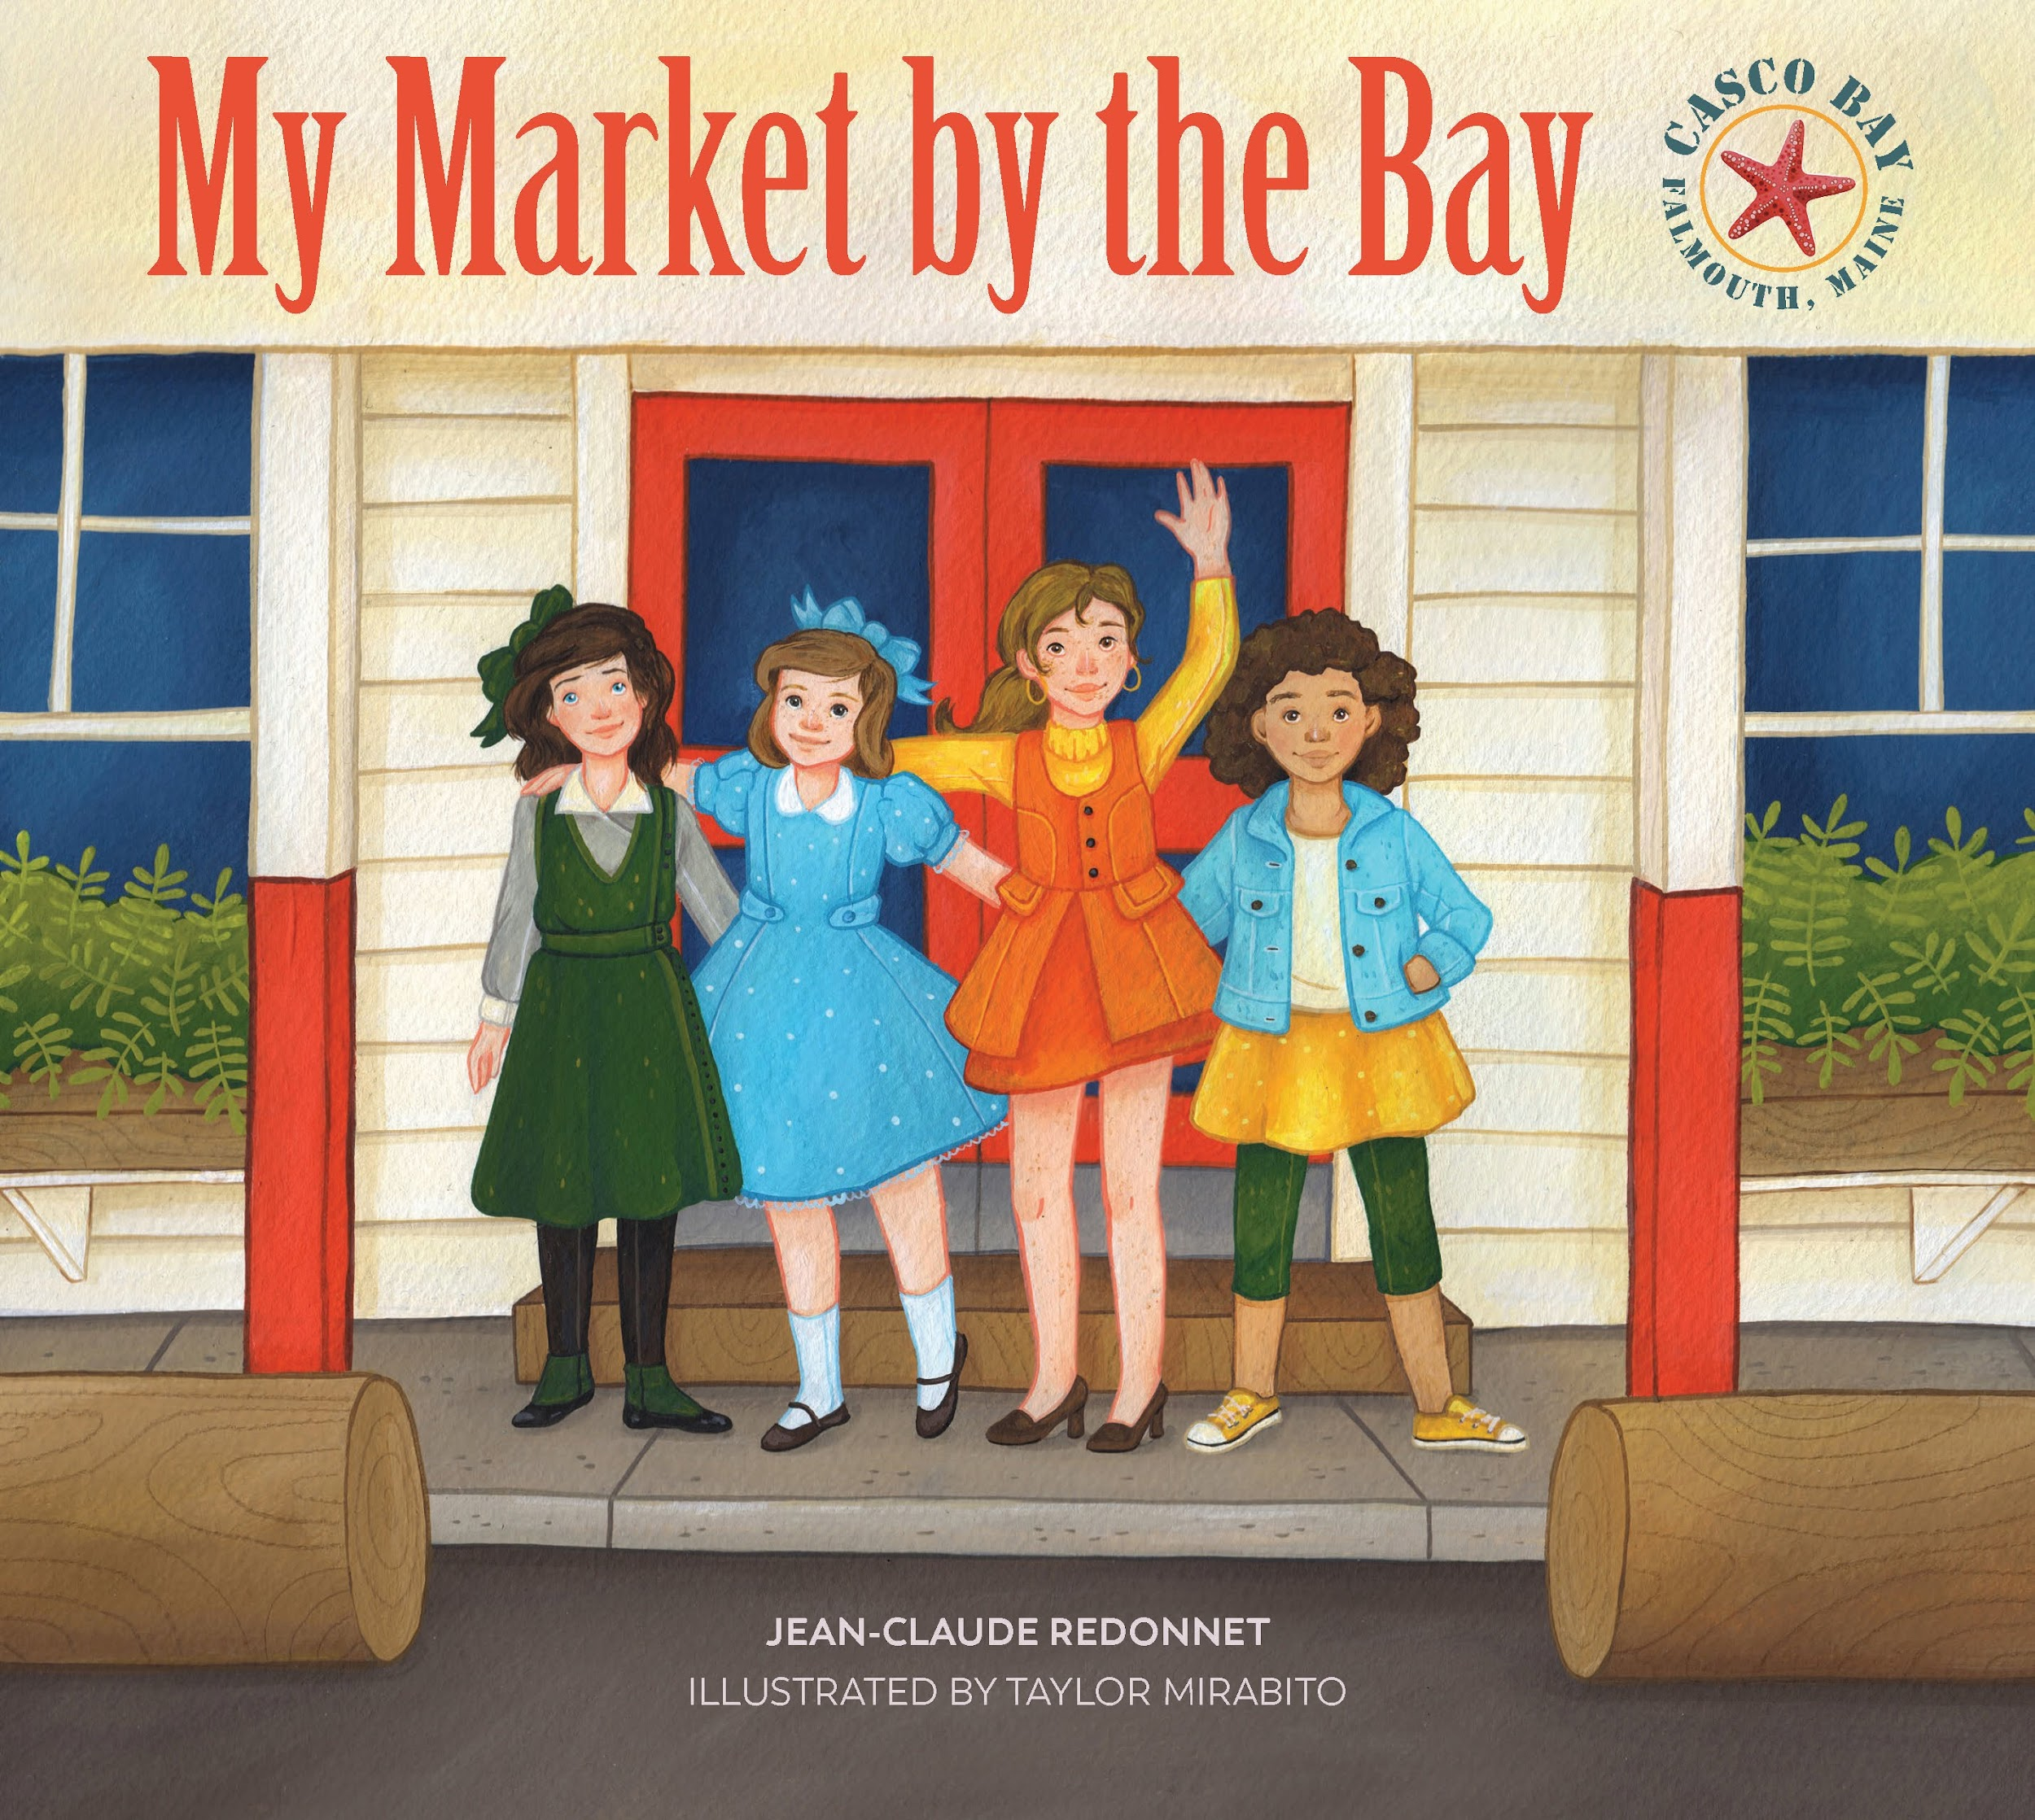
Process
55

Slide 56
Activity 5.2 – Choosing an Illustration Style
56

Slide 57
Activity 5.2 – Choosing an Illustration Style (2)
Reflect on the content and determine what kinds of illustrations you would imagine for this title.
I Like to Read
Author: Letta Machogo
I like to read. Who can I read to? My sister is asleep. Who can I read to? My mother and grandmother are busy. Who can I read to? My father and grandfather are busy. Who can I read to? I can read to myself!
57

Slide 58
SESSION 6: Project Management of a Book Project
Objectives
Describe the phases of a book publishing project and the teamwork involved in creating a book
Describe how to schedule and resource a publishing project
Articulate how to maintain quality control of a publishing project
58

Slide 59
Developing a Set of TLMs
Assume the following specification for a project:
Grades 1-3, Early Grade Reading, Local language
A set consists of: Core student book, Teacher’s Guide, Set of Decodable and Leveled Readers
Planning starts February
Finalized Curriculum and Scope & Sequence
Materials must be delivered by October 1
59

Slide 60
Project Management
Scope
Time
Money
Quality
Communications
Human resources
Risk-Management
60

Slide 61
Stages of a Book Project
Conceptualization
Planning
Implementation
61

Slide 62
Conceptualization
62

Slide 63
Conceptualization (2)
63

Slide 64
Conceptualization (3)
Writing Guidelines
[A-head] Build Background (1 page)
[B-head indicates topic of background information]
Write one or two brief paragraphs of information that will help students better understand the reading.
You may include a spec for a piece of art if it will enhance students’ background knowledge.
The Build Background text must be factually accurate.
Writing Template
[A Head] Build Background
[B Head] <topic of background information>
<background information; 1-2 paragraphs>
[C-A-<#>-1: / C-P-<#>-6: <art/photo spec that will enhance background information>]
Final Activity
64

Slide 65
Planning
Schedule: 1 Book
65

Slide 66
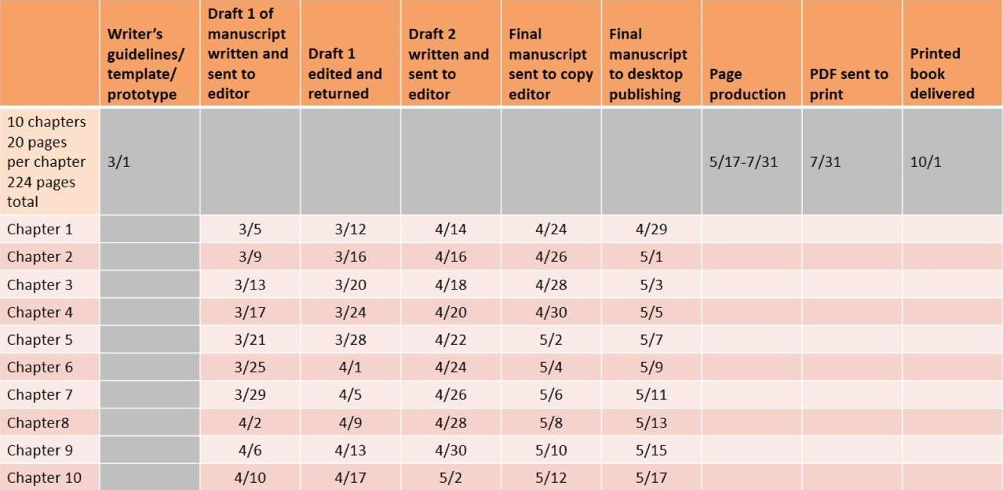
Implementation
Schedule: 1 Book
Writing
Writers can create 3-5 pages/day
There are 30 working days between 3/1 and 4/10
One writer can write a maximum of 150 pages
So need 2 writers for 224 pages
Editorial (Draft 1)
Editing pace: 24 pages/day
30 working days between 3/5 and 4/17
One editor can read 720 pages
So, need only 1 editor for 224 pages
66

Slide 67
Activity 6.1 – Establishing a Project Schedule
67

Slide 68
Activity 6.1 - Instructions
Read Handout 5: Book Schedule
In small groups, imagine you are a publisher faced with developing a full set of curriculum materials for Grades 1-3 to teach early grade reading in a local language.
Analyze the needs of one 224-page book along with the parameters provided to determine how many writers and editors should be assigned to the program.
Each group share the results of their analysis.
Discuss the following question:
With so many writers and editors involved, how can you ensure the quality of the final books?
68

Slide 69
SESSION 7: Wrap Up and Reflection on the Workshop
Objectives
Articulate how they will use what they have learned in the training in their work
Provide feedback on the module
69

Slide 70
Activity 7.1–Taking Action & Expectations Review
70

Slide 71
Evaluation Questionnaire
Please complete the Evaluation Questionnaire and hand it in before leaving the training. The evaluation is anonymous and is very helpful in improving the course for the future. Your feedback is greatly appreciated!
https://edc.co1.qualtrics.com/jfe/form/SV_aawr3DezY6wAPUG
Thank you!
71

Slide 72
Attributions
Slide 4:
Photo credit: USAID/Carole Douglis; USAID Kenya and East Africa
Slide 13:
Photo:Burt Granofsky/EDC
Slide 15:
Logos used with permission from respective organizations
Slide 18:
“I Can Help” by Mini Shrinivasan and illustrated by Aman Randhawa is licensed under CC BY 4.0
72

Slide 73
Attributions (2)
Slide 24:
"Cow with One Horn" by Sebongile Daniel, Mpho Ntlhanngoe, and Khothatso Ranoosi; illustrated by Marion Drew; and published by African Storybook Initiative is licensed under CC BY 4.0
"Cloud Party" by Room to Read and Isuri Dayaratne (Colombo: Room to Read, 2016)
Slide 25:
"A Journey" by Trang Hunyh Nhu Tran and Le Thanh Xuan, An Unforgettable Adventure (Dar es Salaam: Room to Read, 2017)
"Kanchha, the Rhino" by Shannon David and Abin Shrestha, illustrated by Abin Shrestha, and published by Room to Read is licensed under CC BY 4.0
73

Slide 74
Attributions (3)
Slide 26:
"Wild Cat, Wild Cat" by Sejal Mehta, illustrated by Rohan Chakravarty, and published by Pratham books is licensed under CC BY 4.0
Slide 30:
"Riddle" by Save the Children the Children and the Ministry of Education is licensed CC BY 4.0
“Matos el Mono” by Alejandra R. Mielke and illustrated by Karen Medina, produced by the USAID Honduras Reading Activity and the Honduran Secretariat of Education
Slide 31:
"Homes" by Zimbili Dlamini, and published by Let´s Read, The Asia Foundation is licensed CC BY 4.0
"Golden Bird" by Alisha Berger, illustrated by Swarga Bhattacharya, published by Room to Read is licensed CC BY 4.0
74

Slide 75
Attributions (4)
Slide 36: Created by author, Shirin Lutfeali
Slide 43: Robledo, A., & Gove, A. (2018). What Works in Early Reading Materials (Knowledge and Practice in International Development, 2). RTI Press Publication No. OP-0058-1902. Research Triangle Park, NC: RTI Press. https://doi.org/10.3768/rtipress.2018.op.0058.1902
Slide 47: Images excerpted from "My Market by the Bay" text by Jean-Claude Redonnet; illustrations by Taylor Mirabito
Slide 48: "Caged Birds of Phnom Penh" © text by Frederick Lipp; illustrations by Ronald Himler
Slide 49: Illustrations from ONE MORNING IN MAINE by Robert McCloskey, copyright 1952,renewed © 1980 by Robert McCloskey. Used by permission of Viking Children's Books, an imprint of Penguin Young Readers Group, a division of Penguin Random House LLC. All rights reserved
75

Slide 76
Attributions (5)
Slide 50: "Caged Birds of Phnom Penh" © text by Frederick Lipp; illustrations by Ronald Himler
Slide 51: Excerpt(s) and Illustrations from RICHARD SCARRY'S WHAT DO PEOPLE DO ALL DAY by Richard Scarry, copyright © 1968 by Richard Scarry, copyright renewed 1996 by Richard Scarry. Used by permission of Random House Children's Books, a division of Penguin Random House LLC. All rights reserved.
Slide 52: "Mirabel, Chat du Monde" © Open Book Editions; text by Jean-Claude Redonnet; illustrations by Kristin Hakim
Slide 55: "My Market by the Bay" © text by Jean-Claude Redonnet; illustrations by Taylor Mirabito
Slides 62-64: “Milestones” published by Heinle Cengage Learning
76

