Slide 1
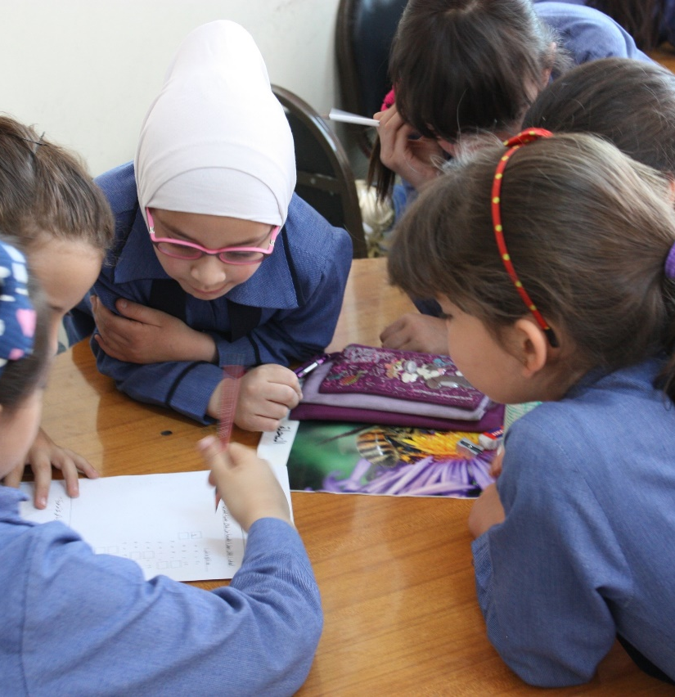
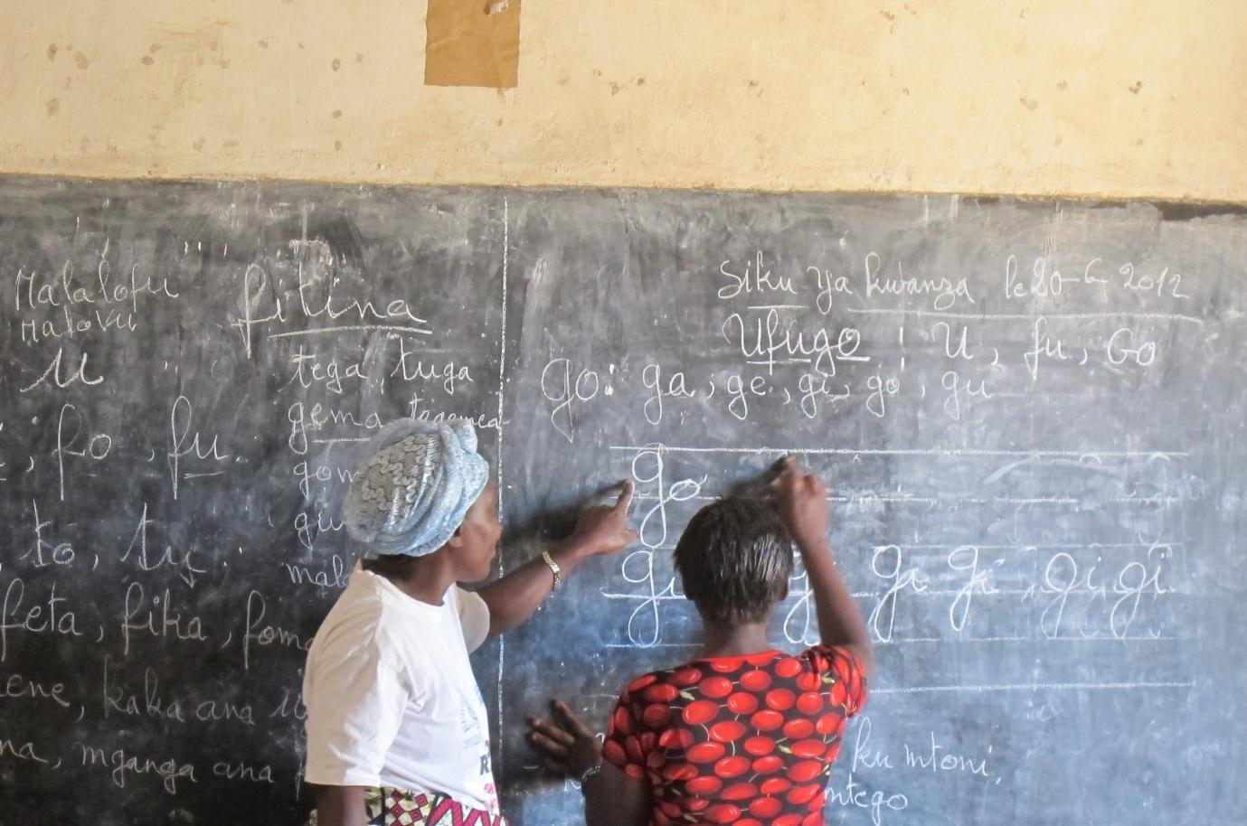
2020 GLOBAL EDUCATION CONFERENCE WEBINAR
Poster Session Design
February 11, 2020

Slide 2
PRESENTERS
The EPIC Project at Training Resources Group, Inc.
Daryn Cambridge, Professional Development Portfolio Manager & Facilitator
Tom Lent, Chief of Party (EPIC) & Facilitator
Juliene Heaney, Event Management Coordinator
Shira Babow, Project Associate

Slide 3
PARTICIPANT POLL (I)
Have you ever delivered a poster presentation?

Slide 4
PARTICIPANT POLL (II)
On a scale of 1 to 5, how comfortable are you with delivering a poster presentation?

Slide 5
PARTICIPANT POLL (III)
What type of poster presentation are you planning to deliver?

Slide 6
I just gave the best poster presentation ever!
Notes:
The goal of this webinar is to set you all up for success as poster session presenters. We are going to share with you the logistics of your poster session - (1) the overall physical layout of the conference venue and the actual location where you posters and visual displays will be set up, (2) the other resources that will be made available to you when setting up your space, and (3) the actual scheduling and flow of poster sessions throughout the day. Then we will delve into the pedagogy and ask you to consider what kind of experience you want conference participants to have when they visit your poster session and how that will impact how you go about designing your poster and how you plan to engage people.

Slide 7
Coordination & Collaboration
Evidence and Research
Systems Strengthening
Self-Reliance
Notes:
But first let’s revisit what’s bringing us all together. On April 6th, 600 people from across the education sector will flock to Washington, DC to explore a variety of technical areas through the lenses of 4 overarching themes: coordination & collaboration, evidence-based decision-making, self-reliance, and systems strengthening.

Slide 8
Content
+
Pedagogy
=
Learning
Notes:
As the education sector, we will no doubt show up with the important content, information, and stories that can address these themes. We also need to show up with the pedagogy that the research on education tells us actually generates learning results.

Slide 9
Share one tip for designing or delivering a great poster or visual presentation.
Type your comment in the chat window
Notes:
We want to hear from you all to get us started. We learned at the start of the webinar that some of you have experience designing or presenting a poster presentation. We want to give you all 30 second to share one tip you all have for designing or presenting a poster presentation. Please type your comment in the chat window, and then we’ll see how it compares with some of the tips we’ll share in this webinar.

Slide 10
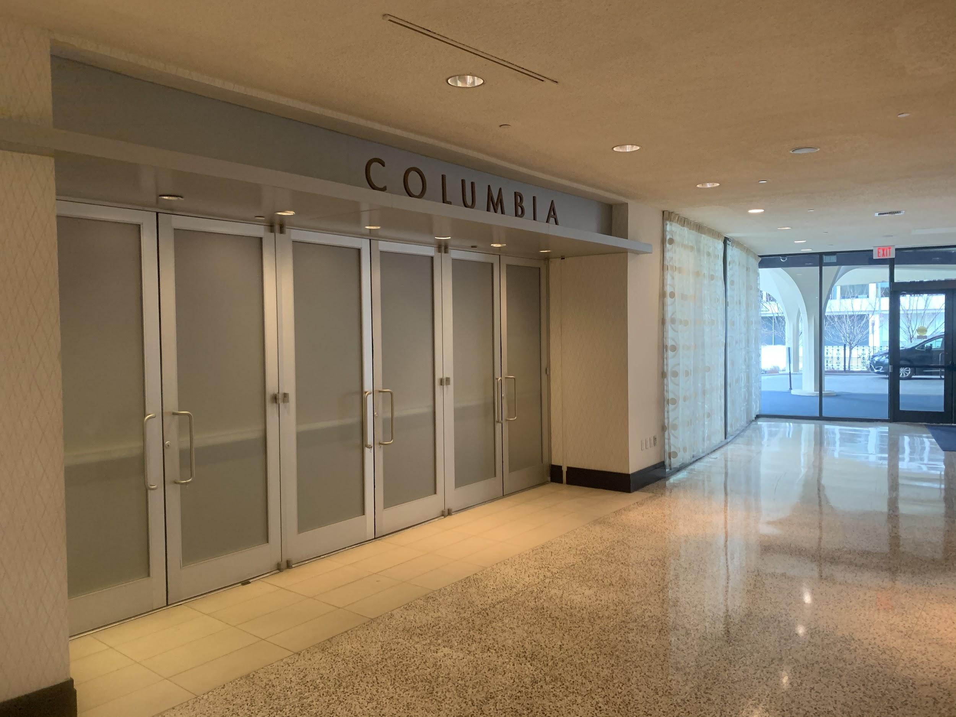
Notes:
What’s the space you’ll be working with? The Hilton Dupont in Washington, DC. This is the entrance to the main conference area, where most of the the global education conference will be happening. Let’s walk through the doors...

Slide 11
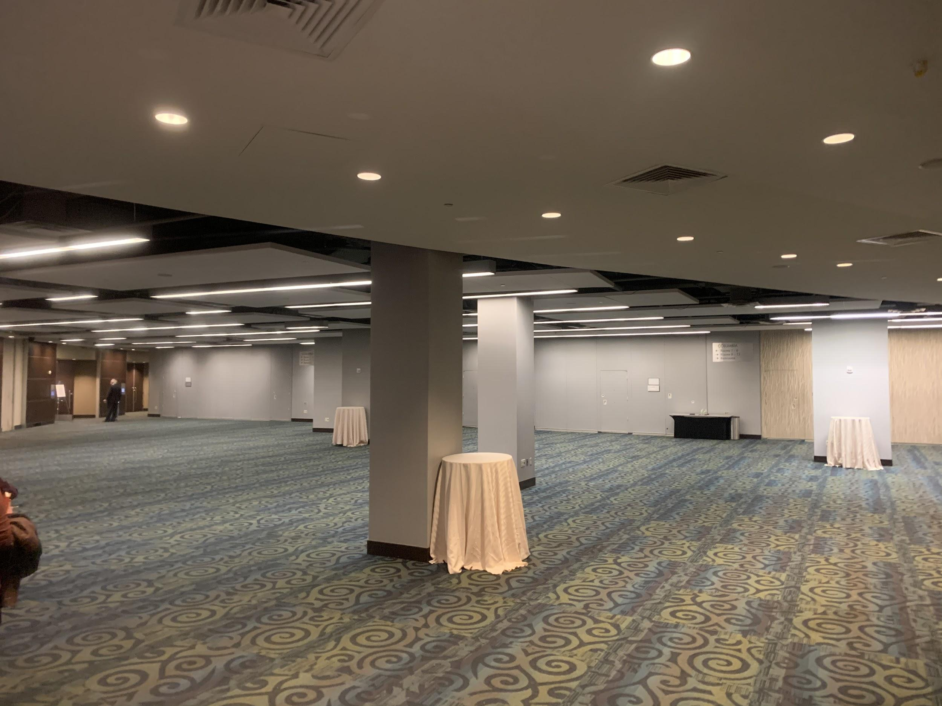
Notes:
Once you walk through those doors this is what you will see. What you are looking at is the main open space where conference attendees can gather in between sessions - during breaks and lunch. If you go through the doors of the gray wall in the back of this photo, that’s where the main plenary space is set up, holding 600 people. In addition to that large plenary space, some of the breakout rooms where some of the sessions will be held can be accessed from this space. Other breakout rooms are one floor above. Around the corner, as you follow the read arrow is where the poster sessions will take place. Let’s take you there now...

Slide 12
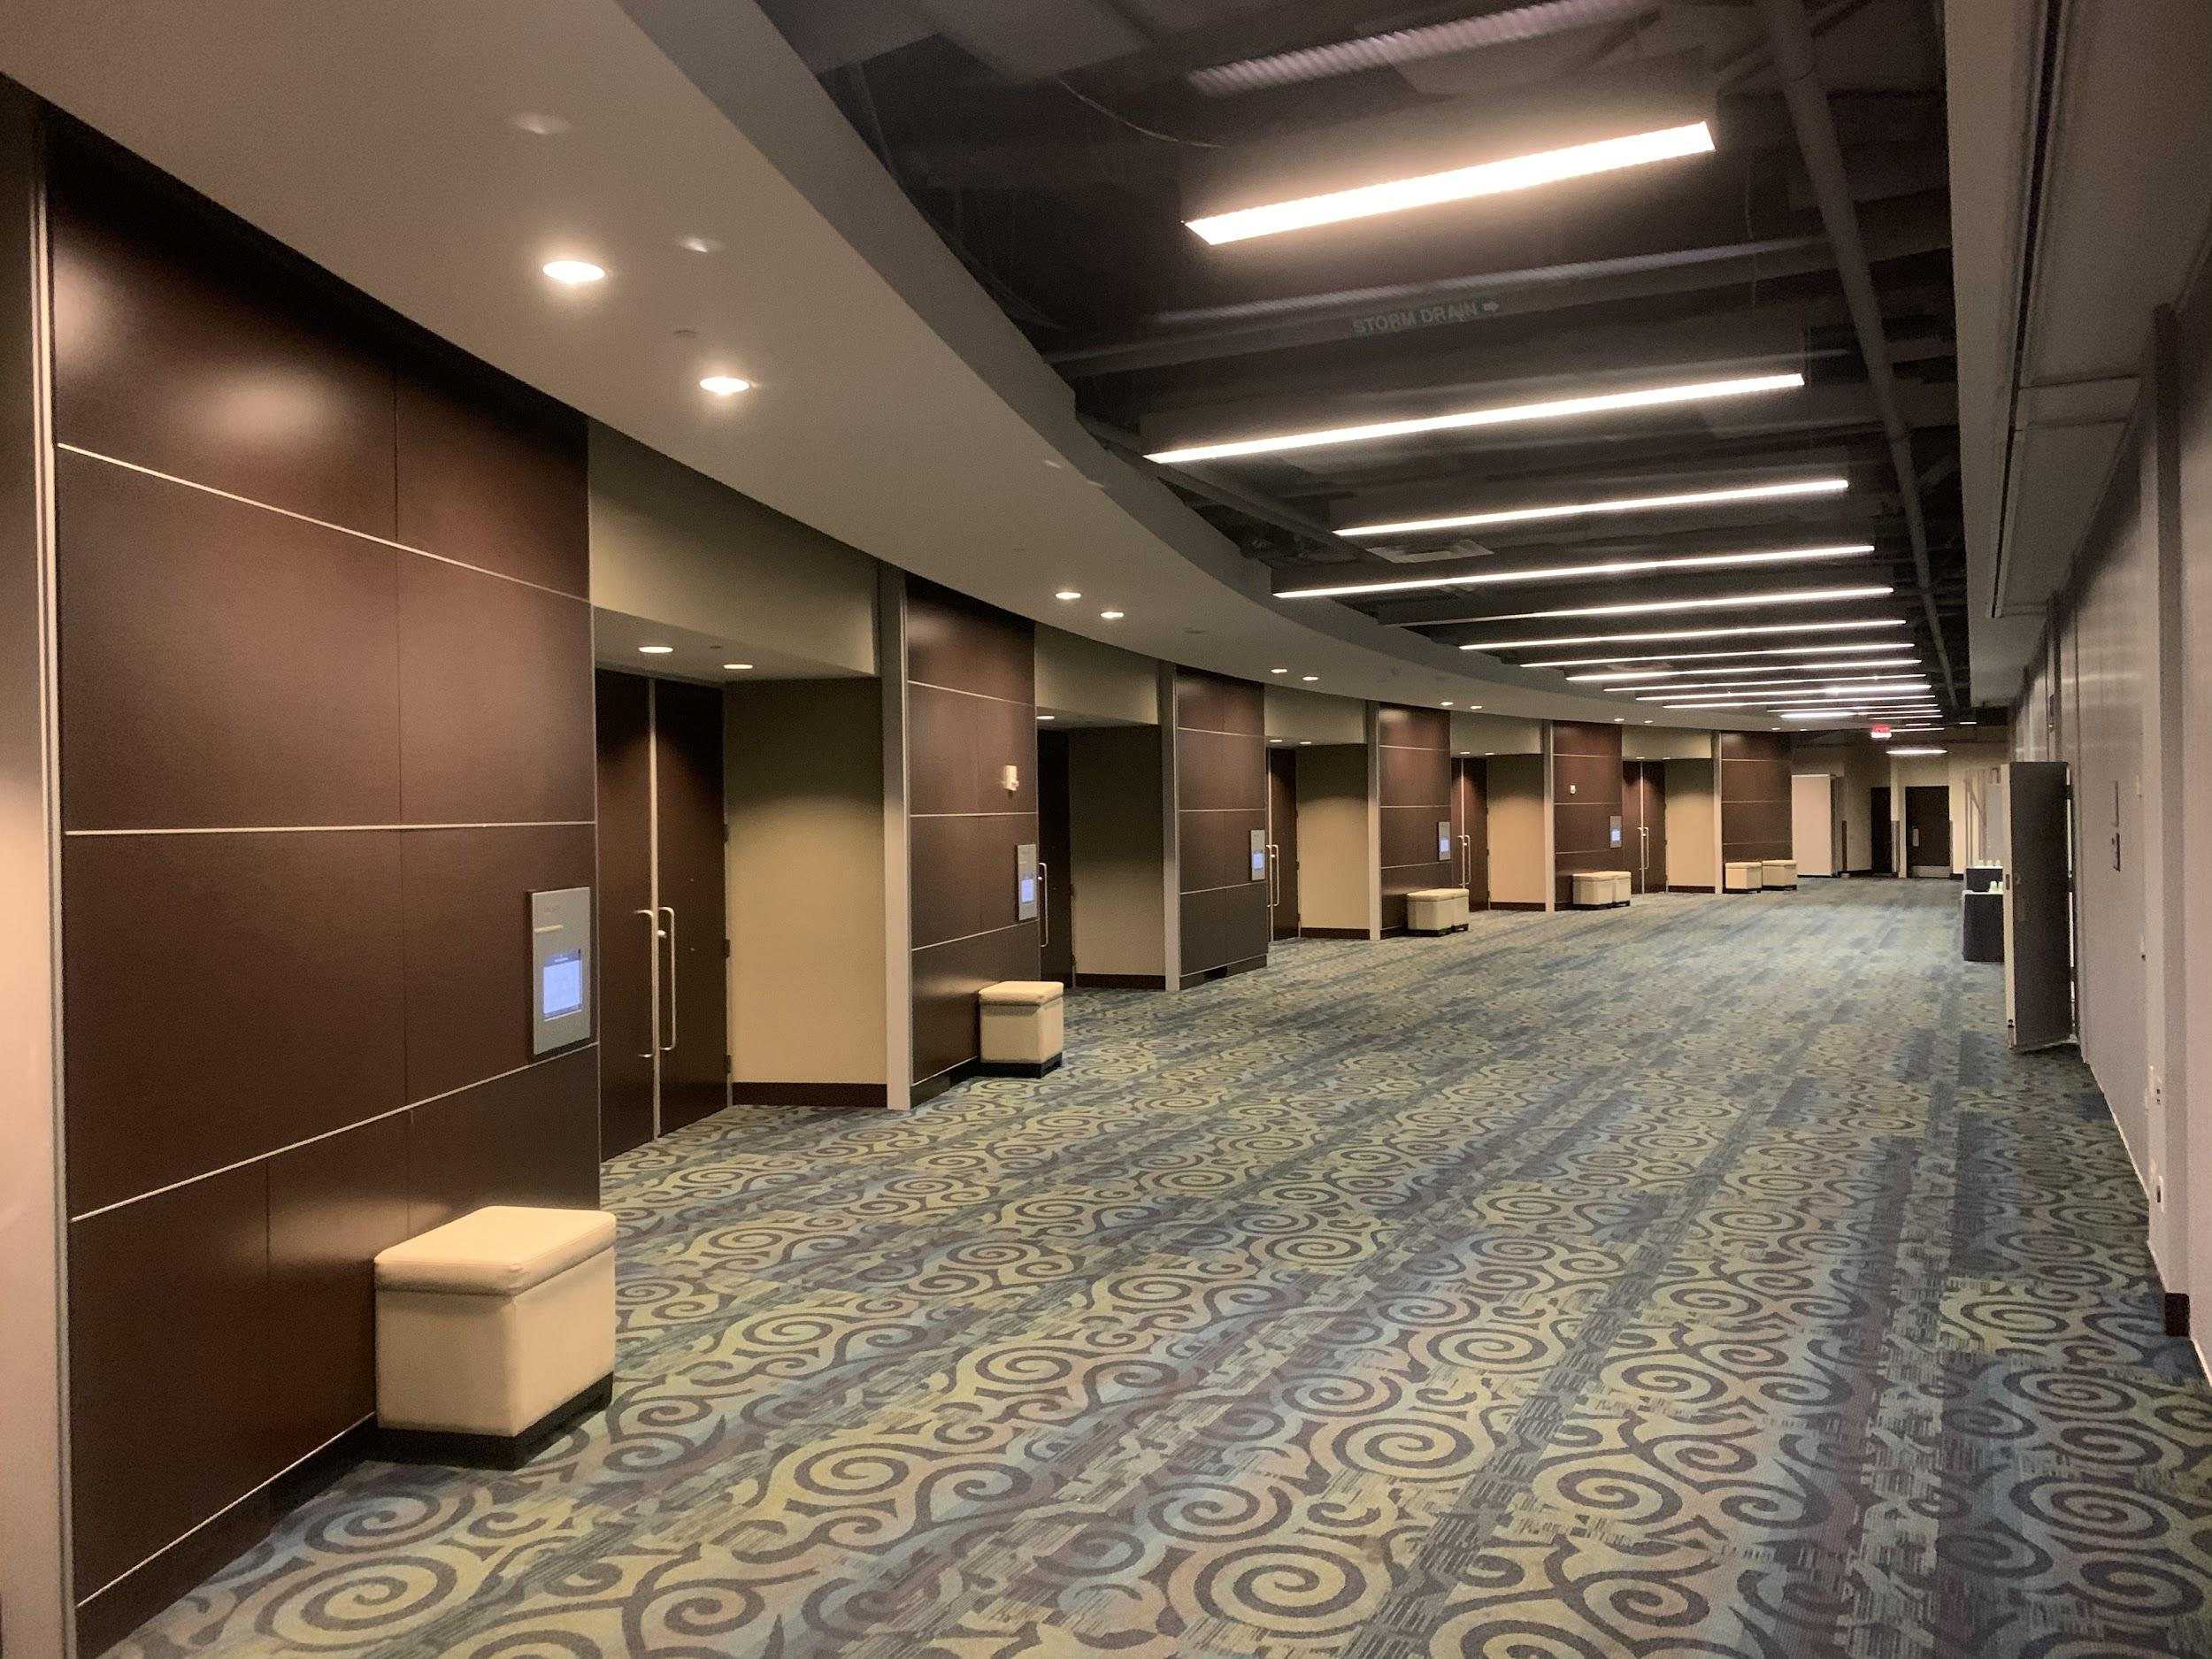
2
3
4
1
Notes:
As you can see, there are four dedicated spaces where a poster can be set up. The red dotted line (towards the back of the photo) is where our conference space ends and another conference’s space begins.

Slide 13
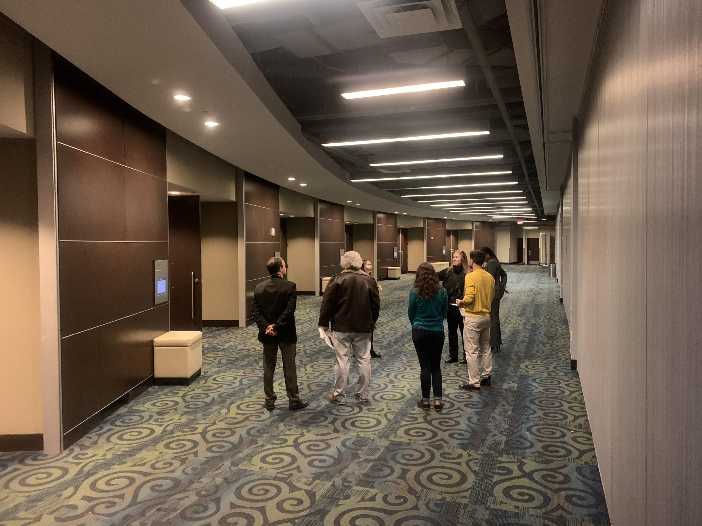
Notes:
This photo with people gives you a sense of scale and can give you a better idea about how many people may be gathering around your poster.

Slide 14
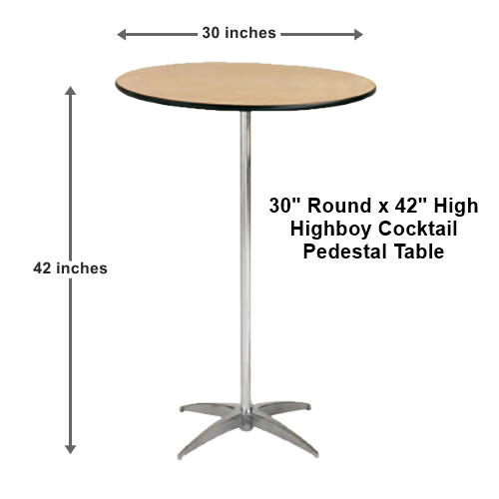
Notes:
Two other things you may have access to, if you wish, are a 3ft tall highboy round table to place handouts, a laptop, etc. You will also have the option of using a flip chart easel.

Slide 15
THE CONFERENCE WILL NOT BE PROVIDING:
Electricity/Power Cords
Laptops
Monitors
Slide Advancers
Seating for either presenters or attendees (reasonable accommodations will be made for presenters with special needs)
Notes:
No electrical hook up - If you choose to use a laptop to show video, slideshows, etc. it will need to run off battery power.
There will be no chair provided unless required for accessibility purposes.

Slide 16
HOW IT WORKS
4
3
30
Poster spaces per day
Periods per day where posters are being presented
(Mon-Tues)
Minutes per period
Notes:
To note:
Gallery Walks occur at the same time as breaks,
On public days, you will have 3 periods (30 minutes each); on internal days, they have 1 period
We recommend that you design a short (5-10 minute) presentation that you can give multiple times during a break period

Slide 17
Plenary 9:30am - 11:00am
Poster Presentations (Break) 11:00am - 11:30am
Concurrent Sessions 11:30am - 12:30pm
Lunch 12:30pm - 1:30pm
Concurrent Session 1:30pm - 2:30pm
Poster Presentations (Break) 2:30pm - 3:00pm
Concurrent Sessions 3:00pm - 4:00pm
Poster Presentations (Break) 4:00pm - 4:30pm
Concurrent Sessions 4:30pm - 5:30pm
Notes:
This is what it looks like on the schedule. What you are looking at is the schedule for Monday. The yellow highlighted times are when your poster presentation will be on display. The poster presentations are part of what we are referring to as a gallery walk. That being a gallery of posters and visual displays that are up and accessible when people break from the concurrent sessions and go back out into the main public space to grab coffee, network, and mingle.

Slide 18
Q & A
Notes:
We are going to pause here and take 2-3 questions on the physical layout and setup logistics for your poster presentations. I will give folks 20 seconds to start typing their questions in the chat window and then we will address them as they come in. We will have additional Q&A at the end, so don’t worry if your question doesn’t get answered during this portion.

Slide 19
Graphics
Limited Text
Prepared
Handouts
Notes:
Now that we touched on the physical layout, space and set up consideration, let’s look at what research tells us about effective presentations and learning. When presenting information, retention is increased by 28% when graphics are used, text is limited, the conversation is prepared, and job aids or handouts are provided. So, given this, let’s think about the various ways you might want folks to engage with your content, your poster, and you.

Slide 20
POSTER SESSION ENGAGEMENT
Walk & Read
One on One
Small Group
Participant Contributions
Product Dissemination
Notes:
What kind of poster session experience do you want to deliver for the conference attendees?
The participants walk by and read on their own
You speak to a small-medium sized group of 6-20 people at a time.
You have small group conversations with participants as they stop.
You want to get your product/resource in the hands of as many people as possible.
You want participants to contribute to a conversation/discussion.

Slide 21
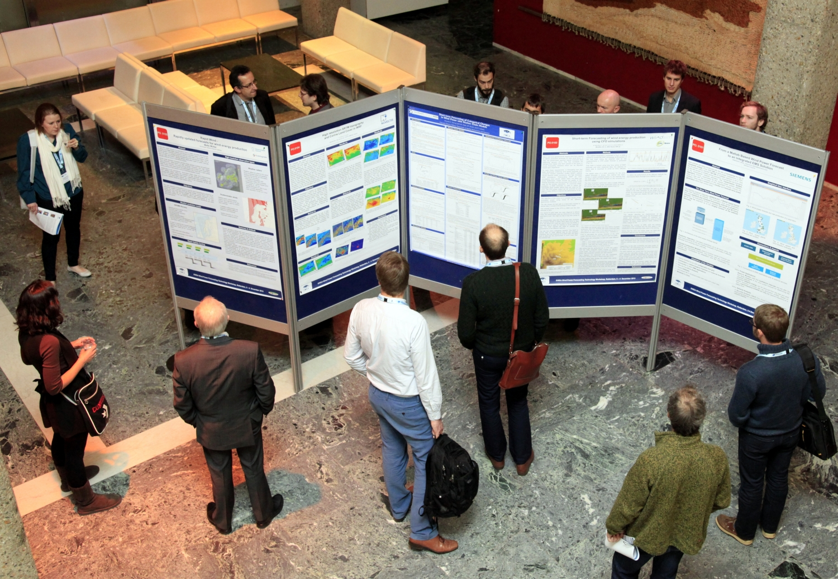
WALK & READ
Notes:
No matter what you decide to do with your poster, and how you plan for people to interact with it and with you, your baseline is always going to be the “Walk by and Read” experience. With that in mind, a couple things you should ask yourself are:
How am I going to draw people towards my poster? What is going to capture their attention?
How does the design of my poster accommodate people standing at different distances? That means thinking about font size, colors, spacing of content and graphics, etc.
A great resources to use as a model is the linked in the additional resources at the bottom of the webinar page.
Reference the “better poster resource”

Slide 22
Notes:
Option 1 is the academic poster format - If you have conducted research, written a paper or report that outlines the findings, and you want to share those with conference attendees, this is a good format for you.
Title would be “The Role of Electric-Assist Bicycles in Curbing Climate Change”
Main finding might be: “The rise of electric-assist bicycles in urban centers reduce automobile traffic
Intro text may be:

Slide 23
ONE ON ONE
Notes:
The next level of experience would be having one on one conversations with participants as they come by your poster.
A few questions to consider if this is the experience you are aiming for are:
How long do I want to invest in each conversation/interaction?
Do I have an elevator pitch or short presentation that I can comfortably recycle each time I engage with someone?
Are there handouts I can provide (or QR code) that I can hand people as they move on from our conversation?
Is there a list of questions you are prepared to answer about your poster’s content? If so, you can have those listed on your poster and then have visitors decide which one they want to ask when they talk with you?

Slide 24
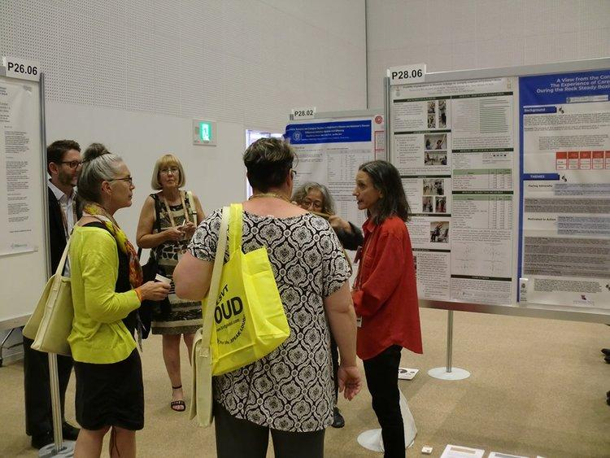
SMALL GROUP CONVERSATIONS
Notes:
The next level of experience would be small group discussions (with 5-10 people) about your poster’s content. A couple questions to consider for this experience would be:
How will you signal for people to gather around?
How many small groups do you want to reach in the time allotted and the space?
What are the main points you want to share in that time frame?
How does your presentation build on or introduce what your poster is communicating - as opposed to just repeating what it is written?

Slide 25
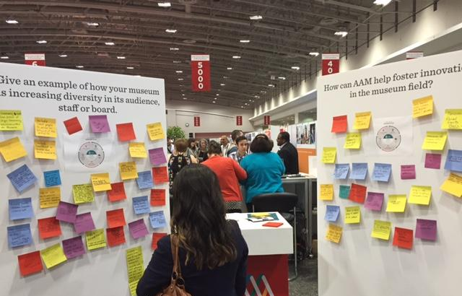
PARTICIPANT CONTRIBUTIONS
Notes:
Another approach would be having participants actually interact with, not just you, but your poster presentation itself. If you are interested in creating this kind of experience, a few questions to consider are:
Are there ideas or examples you want gather from participants to help advance your work?
Are their questions you want to gather from participants and then answer at a later point through a blog on edu-links perhaps or a follow on webinar?
Are their reactions you want to hear from the attendees that can help you refine your work - make it better, more informed, more examples, etc.
Are there people whose information you want to collect in order to facilitate networking around your poster’s topic?
In other words, do you want your session to harvest collective wisdom, knowledge, or inquiries from the larger group?

Slide 26
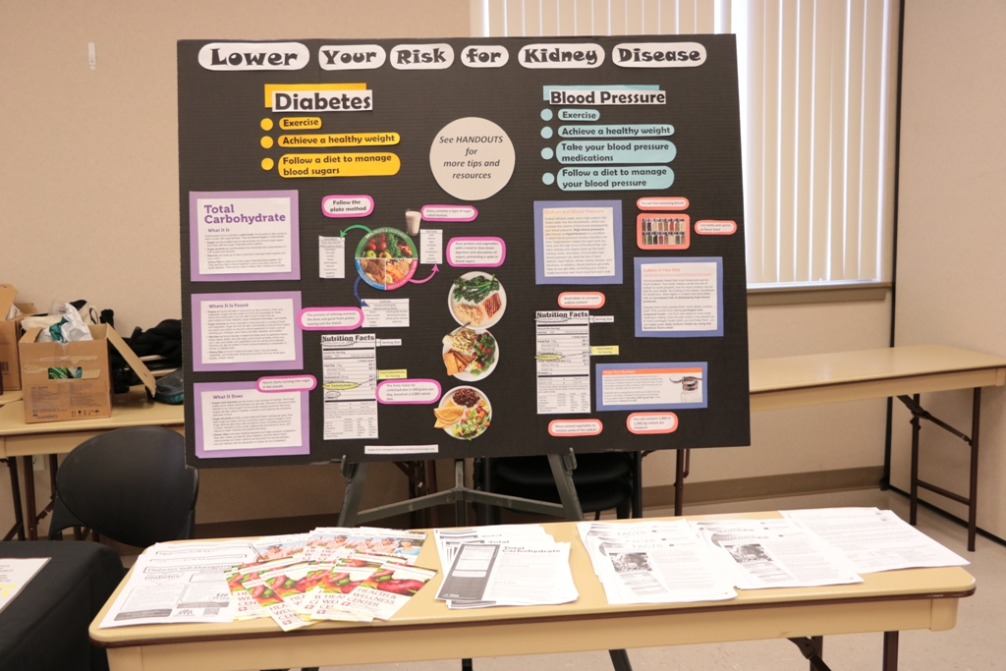
PRODUCT DISSEMINATION

Slide 27
I just gave the best poster presentation ever!

Slide 28
UPCOMING DEADLINES
February 24th: Final day to book hotel rooms (presenters)
February 28th:
Final session title and description added
Preliminary PowerPoint / poster design uploaded
March 20th: Final PowerPoint / poster design uploaded

Slide 29
Q & A

Slide 30
PARTICIPANT TAKEAWAYS
In the chat box, please tell us one thing you will take away from this webinar.

Slide 31
FINAL PARTICIPANT POLL
On a scale of 1 to 5, how comfortable are you with delivering a poster presentation?

Slide 32
Still have questions? Reach out to us at gfu@usaid.gov

